Slide 1
Larvel: Up and Running
Copyright © 2022 by Elephant Scale, All Rights Reserved

Slide 2
Why Laravel?
Copyright © 2022 by Elephant Scale, All Rights Reserved

Slide 3
Why Laravel?
In the early days of the dynamic web, writing a web application looked a lot different than it does today.
Developers then were responsible for writing the code for not just the unique business logic of our applications, but also each of the components that are so common across sites—user authentication, input validation, database access, templating, and more.
Today, programmers have dozens of application development frameworks and thousands of components and libraries easily accessible
Copyright © 2022 by Elephant Scale, All Rights Reserved
Notes:
. It’s a common refrain among programmers that, by the time you learn one framework, three newer (and purportedly better) frameworks have popped up intending to replace it.
“Just because it’s there” might be a valid justification for climbing a mountain, but there are better reasons to choose to use a specific framework—or to use a framework at all. It’s worth asking the question, why frameworks? More specifically, why Laravel?

Slide 4
Why Use a Framework?
It’s easy to see why it’s beneficial to use the individual components, or packages, that are available to PHP developers.
With packages, someone else is responsible for developing and maintaining an isolated piece of code that has a well-defined job, and in theory that person has a deeper understanding of this single component than you have time to have.
Copyright © 2022 by Elephant Scale, All Rights Reserved
Notes:
Frameworks like Laravel—and Symfony, Lumen, and Slim—prepackage a collection of third-party components together with custom framework “glue” like configuration files, service providers, prescribed directory structures, and application bootstraps. So, the benefit of using a framework in general is that someone has made decisions not just about individual components for you, but also about how those components should fit together.

Slide 5
I’ll Just Build It Myself”
“Let’s say you start a new web app without the benefit of a framework.
Where do you begin? Well, it should probably route HTTP requests, so you now need to evaluate all of the HTTP request and response libraries available and pick one, Then you’ll have to pick a router. Oh, and you’ll probably need to set up some form of routes configuration file. What syntax should it use? Where should it go?
What about controllers? Where do they live, and how are they loaded? Well, you probably need a dependency injection container to resolve the controllers and their dependencies. But which one?
Copyright © 2022 by Elephant Scale, All Rights Reserved
Notes:
Furthermore, if you do take the time to answer all those questions and successfully create your application, what’s the impact on the next developer? What about when you have four such custom framework–based applications, or a dozen, and you have to remember where the controllers live in each, or what the routing syntax is?

Slide 6
Consistency and Flexibility
Frameworks address this issue by providing a carefully considered answer to the question “Which component should we use here?” and ensuring that the particular components chosen work well together.
Additionally, frameworks provide conventions that reduce the amount of code a developer new to the project has to understand—if you understand how routing works in one Laravel project, for example, you understand how it works in all Laravel projects.
Copyright © 2022 by Elephant Scale, All Rights Reserved
Notes:
When someone prescribes rolling your own framework for each new project, what they’re really advocating is the ability to control what does and doesn’t go into your application’s foundation. That means the best frameworks will not only provide you with a solid foundation, but also give you the freedom to customize to your heart’s content. And this, as I’ll show you in the rest of this course, is part of what makes Laravel so special.

Slide 7
A Short History of Web and PHP Frameworks
An important part of being able to answer the question “Why Laravel?” is understanding Laravel’s history—and understanding what came before it. Prior to Laravel’s rise in popularity, there were a variety of frameworks and other movements in PHP and other web development spaces.
Ruby on Rails
The Influx of PHP Frameworks
The Good and the Bad of CodeIgniter
Laravel 1, 2, and 3
Laravel 4
Laravel 5
Laravel 6
Copyright © 2022 by Elephant Scale, All Rights Reserved
Notes:
Ruby on Rails
David Heinemeier Hansson released the first version of Ruby on Rails in 2004, and it’s been hard to find a web application framework since then that hasn’t been influenced by Rails in some way.
Rails popularized MVC, RESTful JSON APIs, convention over configuration, ActiveRecord, and many more tools and conventions that had a profound influence on the way web developers approached their applications—especially with regard to rapid application development.
The Influx of PHP Frameworks
It was clear to most developers that Rails and similar web application frameworks were the wave of the future, and PHP frameworks, including those admittedly imitating Rails, started popping up quickly.
CakePHP was the first in 2005, and it was soon followed by Symfony, CodeIgniter, Zend Framework, and Kohana (a CodeIgniter fork). Yii arrived in 2008, and Aura and Slim in 2010. 2011 brought FuelPHP and Laravel, both of which were not quite CodeIgniter offshoots, but instead proposed as alternatives.
Some of these frameworks were more Rails-y, focusing on database object-relational mappers (ORMs), MVC structures, and other tools targeting rapid development. Others, like Symfony and Zend, focused more on enterprise design patterns and ecommerce.
The Good and the Bad of CodeIgniter
CakePHP and CodeIgniter were the two early PHP frameworks that were most open about how much their inspiration was drawn from Rails. CodeIgniter quickly rose to fame and by 2010 was arguably the most popular of the independent PHP frameworks.
CodeIgniter was simple, easy to use, and boasted amazing documentation and a strong community. But its use of modern technology and patterns advanced slowly; and as the framework world grew and PHP’s tooling advanced, CodeIgniter started falling behind in terms of both technological advances and out-of-the-box features. Unlike many other frameworks, CodeIgniter was managed by a company, and it was slow to catch up with PHP 5.3’s newer features like namespaces and the moves to GitHub and later Composer. It was in 2010 that Taylor Otwell, Laravel’s creator, became dissatisfied enough with CodeIgniter that he set off to write his own framework.
Laravel 1, 2, and 3
The first beta of Laravel 1 was released in June 2011, and it was written completely from scratch. It featured a custom ORM (Eloquent); closure-based routing (inspired by Ruby Sinatra); a module system for extension; and helpers for forms, validation, authentication, and more.
Early Laravel development moved quickly, and Laravel 2 and 3 were released in November 2011 and February 2012, respectively. They introduced controllers, unit testing, a command-line tool, an inversion of control (IoC) container, Eloquent relationships, and migrations.
Laravel 4
With Laravel 4, Taylor rewrote the entire framework from the ground up. By this point Composer, PHP’s now-ubiquitous package manager, was showing signs of becoming an industry standard, and Taylor saw the value of rewriting the framework as a collection of components, distributed and bundled together by Composer.
Taylor developed a set of components under the code name Illuminate and, in May 2013, released Laravel 4 with an entirely new structure. Instead of bundling the majority of its code as a download, Laravel now pulled in the majority of its components from Symfony (another framework that released its components for use by others) and the Illuminate components through Composer.
Laravel 4 also introduced queues, a mail component, facades, and database seeding. And because Laravel was now relying on Symfony components, it was announced that Laravel would be mirroring (not exactly, but soon after) the six-monthly release schedule Symfony follows.
Laravel 5
Laravel 4.3 was scheduled to release in November 2014, but as development progressed it became clear that the significance of its changes merited a major release, and Laravel 5 was released in February 2015.
Laravel 5 featured a revamped directory structure, removal of the form and HTML helpers, the introduction of the contract interfaces, a spate of new views, Socialite for social media authentication, Elixir for asset compilation, Scheduler to simplify cron, dotenv for simplified environment management, form requests, and a brand new REPL (read–evaluate–print loop). Since then it’s grown in features and maturity, but there have been no major changes like in previous versions.
Laravel 6
In September 2019, Laravel 6 was introduced. There are two primary changes it introduced: first, removal of the string and array global helpers Laravel offers (in favor of Facades); and second, moving to SemVer for version numbering. The practical effect of this change means that for all versions of Laravel after 5, major (6, 7, etc.) and minor (6.1, 6.2, etc.) versions are released much more frequently.

Slide 8
What’s So Special About Laravel?
So what is it that sets Laravel apart?
Why is it worth having more than one PHP framework at any time?
They all use components from Symfony anyway, right?
Let’s talk a bit about what makes Laravel “tick.”
Copyright © 2022 by Elephant Scale, All Rights Reserved

Slide 9
The Philosophy of Laravel
You only need to read through the Laravel marketing materials and READMEs to start seeing its values, Taylor uses light-related words like “Illuminate” and “Spark.”
And then there are these: “Artisans.” “Elegant.” Also, these: “Breath of fresh air.” “Fresh start.” And finally: “Rapid.” “Warp speed.”
The two most strongly communicated values of the framework are to increase developer speed and developer happiness.
Taylor has described the “Artisan” language as intentionally contrasting against more utilitarian values.
Copyright © 2022 by Elephant Scale, All Rights Reserved
Notes:
You can see the genesis of this sort of thinking in his 2011 question on StackExchange in which he stated, “Sometimes I spend ridiculous amounts of time (hours) agonizing over making code ‘look pretty’”—just for the sake of a better experience of looking at the code itself. And he’s often talked about the value of making it easier and quicker for developers to take their ideas to fruition, getting rid of unnecessary barriers to creating great products.
Laravel is, at its core, about equipping and enabling developers. Its goal is to provide clear, simple, and beautiful code and features that help developers quickly learn, start, and develop, and write code that’s simple, clear, and lasting.
The concept of targeting developers is clear across Laravel materials. “Happy developers make the best code” is written in the documentation. “Developer happiness from download to deploy” was the unofficial slogan for a while. Of course, any tool or framework will say it wants developers to be happy. But having developer happiness as a primary concern, rather than secondary, has had a huge impact on Laravel’s style and decision-making progress. Where other frameworks may target architectural purity as their primary goal, or compatibility with the goals and values of enterprise development teams, Laravel’s primary focus is on serving the individual developer. That doesn’t mean you can’t write architecturally pure or enterprise-ready applications in Laravel, but it won’t have to be at the expense of the readability and comprehensibility of your codebase.

Slide 10
How Laravel Achieves Developer Happiness
Just saying you want to make developers happy is one thing.
Doing it is another, and it requires you to question what in a framework is most likely to make developers unhappy and what is most likely to make them happy.
There are a few ways Laravel tries to make developers’ lives easier.
First, Laravel is a rapid application development framework.
That means it focuses on a shallow (easy) learning curve and on minimizing the steps between starting a new app and publishing it.
Copyright © 2022 by Elephant Scale, All Rights Reserved
Notes:
All of the most common tasks in building web applications, from database interactions to authentication to queues to email to caching, are made simpler by the components Laravel provides. But Laravel’s components aren’t just great on their own; they provide a consistent API and predictable structures across the entire framework. That means that, when you’re trying something new in Laravel, you’re more than likely going to end up saying, “… and it just works.”
This doesn’t end with the framework itself, either. Laravel provides an entire ecosystem of tools for building and launching applications. You have Homestead and Valet for local development, Forge for server management, and Envoyer for advanced deployment. And there’s a suite of add-on packages: Cashier for payments and subscriptions, Echo for WebSockets, Scout for search, Passport for API authentication, Dusk for frontend testing, Socialite for social login, Horizon for monitoring queues, Nova for building admin panels, and Spark to bootstrap your SaaS. Laravel is trying to take the repetitive work out of developers’ jobs so they can do something unique.
Next, Laravel focuses on “convention over configuration”—meaning that if you’re willing to use Laravel’s defaults, you’ll have to do much less work than with other frameworks that require you to declare all of your settings even if you’re using the recommended configuration. Projects built on Laravel take less time than those built on most other PHP frameworks.
Laravel also focuses deeply on simplicity. It’s possible to use dependency injection and mocking and the Data Mapper pattern and repositories and Command Query Responsibility Segregation and all sorts of other more complex architectural patterns with Laravel, if you want. But while other frameworks might suggest using those tools and structures on every project, Laravel and its documentation and community lean toward starting with the simplest possible implementation—a global function here, a facade there, ActiveRecord over there. This allows developers to create the simplest possible application to solve for their needs, without limiting its usefulness in complex environments.
An interesting source of how Laravel is different from other PHP frameworks is that its creator and its community are more connected to and inspired by Ruby and Rails and functional programming languages than by Java. There’s a strong current in modern PHP to lean toward verbosity and complexity, embracing the more Java-esque aspects of PHP. But Laravel tends to be on the other side, embracing expressive, dynamic, and simple coding practices and language features.

Slide 11
The Laravel Community
If this course is your first exposure to the Laravel community, you have something special to look forward to.
One of the distinguishing elements of Laravel, which has contributed to its growth and success, is the welcoming, teaching community that surrounds it.
From Jeffrey Way’s Laracasts video tutorials to Laravel News to Slack and IRC and Discord channels, from Twitter friends to bloggers to podcasts to the Laracon conferences, Laravel has a rich and vibrant community full of folks who’ve been around since day one and folks who are just starting their own “day one.” And this isn’t an accident:
Copyright © 2022 by Elephant Scale, All Rights Reserved
Notes:
From the very beginning of Laravel, I’ve had this idea that all people want to feel like they are part of something. It’s a natural human instinct to want to belong and be accepted into a group of other like-minded people. So, by injecting personality into a web framework and being really active with the community, that type of feeling can grow in the community.
Taylor Otwell, Product and Support interview
Taylor understood from the early days of Laravel that a successful open source project needed two things: good documentation and a welcoming community. And those two things are now hallmarks of Laravel.

Slide 12
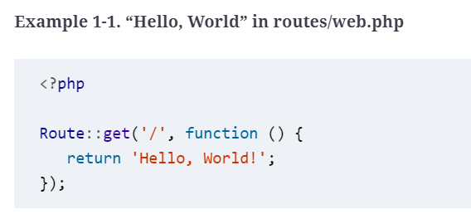
How It Works
Up until now, everything I’ve shared here has been entirely abstract. What about the code, you ask?
Let’s dig into a simple application (Example 1-1) so you can see what working with Laravel day to day is actually like.
Copyright © 2022 by Elephant Scale, All Rights Reserved
Notes:
The simplest possible action you can take in a Laravel application is to define a route and return a result any time someone visits that route. If you initialize a brand new Laravel application on your machine, define the route in Example 1-1, and then serve the site from the public directory, you’ll have a fully functioning “Hello, World” example

Slide 13
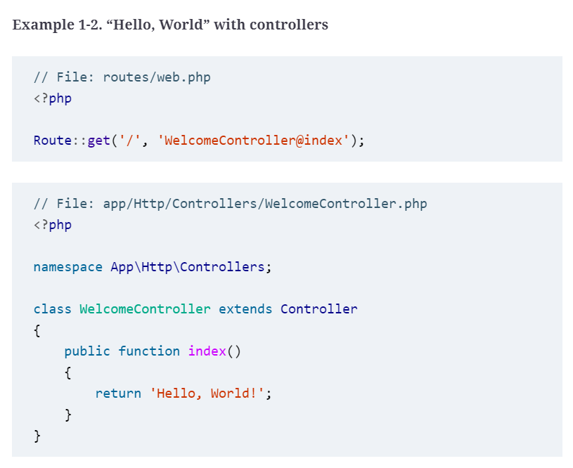
How It Works
It looks very similar with controllers, as you can see in Example 1-2.
Copyright © 2022 by Elephant Scale, All Rights Reserved

Slide 14
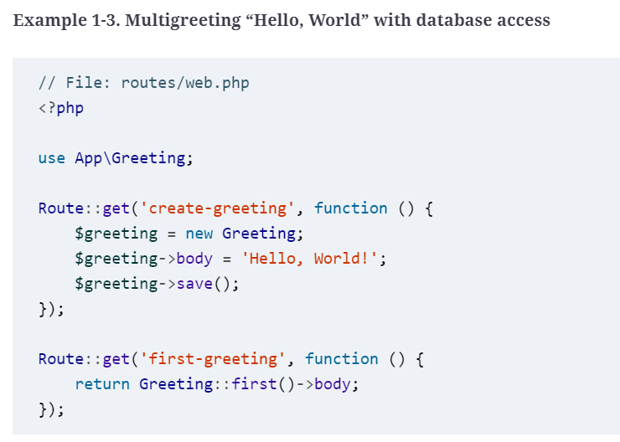
How It Works
If you’re storing your greetings in a database, it’ll also look pretty similar
Copyright © 2022 by Elephant Scale, All Rights Reserved

Slide 15
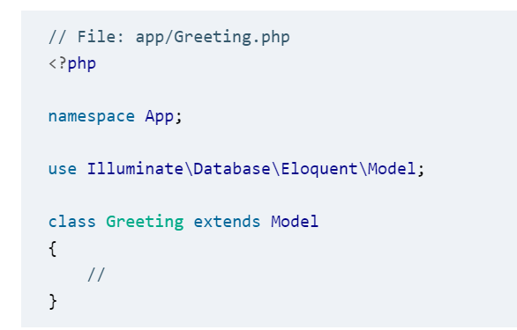
How It Works
Copyright © 2022 by Elephant Scale, All Rights Reserved

Slide 16
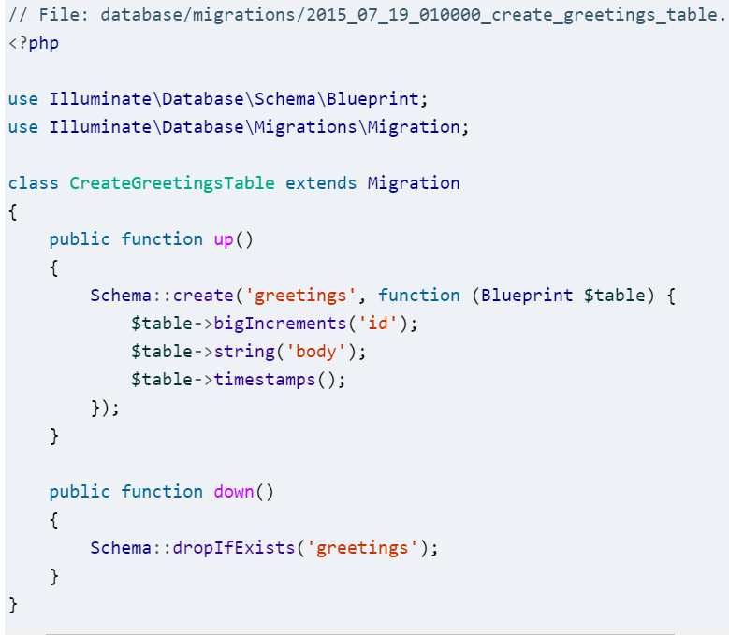
How It Works
Copyright © 2022 by Elephant Scale, All Rights Reserved
Notes:
Example 1-3 might be a bit overwhelming, and if so, just skip over it. You’ll learn about everything that’s happening here in later lessons, but you can already see that with just a few lines of code, you can set up database migrations and models and pull records out. It’s just that simple.

Slide 17
Why Laravel?
Because Laravel helps you bring your ideas to reality with no wasted code, using modern coding standards, surrounded by a vibrant community, with an empowering ecosystem of tools.
And because you, dear developer, deserve to be happy.
Copyright © 2022 by Elephant Scale, All Rights Reserved

Slide 18
Setting Up a Laravel Development Environment
Copyright © 2022 by Elephant Scale, All Rights Reserved

Slide 19
System Requirements
Everything we’ll cover in this lesson is possible with Windows machines, but you’ll need dozens of pages of custom instructions and caveats.
I’ll leave those instructions and caveats to actual Windows users, so the examples here and in the rest of the course will focus on Unix/Linux/macOS developers.
Whether you choose to serve your website by installing PHP and other tools on your local machine, serve your development environment from a virtual machine via Vagrant or Docker, or rely on a tool like MAMP/WAMP/XAMPP.
Copyright © 2022 by Elephant Scale, All Rights Reserved
Notes:
, your development environment will need to have all of the following installed in order to serve Laravel sites:
PHP >= 7.1.3 for Laravel versions 5.6 to 5.8, PHP >= 7.0.0 for version 5.5, PHP >= 5.6.4 for version 5.4, PHP between 5.6.4 and 7.1.* for version 5.3, or PHP >= 5.5.9 for versions 5.2 and 5.1
OpenSSL PHP extension
PDO PHP extension
Mbstring PHP extension
Tokenizer PHP extension
XML PHP extension (Laravel 5.3 and higher)
Ctype PHP extension (Laravel 5.6 and higher)
JSON PHP extension (Laravel 5.6 and higher)
BCMath PHP extension (Laravel 5.7 and higher)

Slide 20
Composer
Whatever machine you’re developing on will need to have Composer installed globally.
If you’re not familiar with Composer, it’s a tool that’s at the foundation of most modern PHP development.
Composer is a dependency manager for PHP, much like NPM for Node or RubyGems for Ruby. But like NPM, Composer is also the foundation of much of our testing, local script loading, installation scripts, and much more.
Copyright © 2022 by Elephant Scale, All Rights Reserved
Notes:
You’ll need Composer to install Laravel, update Laravel, and bring in external dependencies.

Slide 21
Local Development Environments
For many projects, hosting your development environment using a simpler toolset will be enough.
If you already have MAMP or WAMP or XAMPP installed on your system, that will likely be fine to run Laravel.
You can also just run Laravel with PHP’s built-in web server, assuming your system PHP is the right version.
All you really need to get started is the ability to run PHP. Everything past that is up to you.
Copyright © 2022 by Elephant Scale, All Rights Reserved
Notes:
However, Laravel offers two tools for local development, Valet and Homestead, and we’ll cover both briefly. If you’re unsure of which to use, I’d recommend using Valet and just becoming briefly familiar with Homestead; however, both tools are valuable and worth understanding.

Slide 22
Laravel Valet
If you want to use PHP’s built-in web server, your simplest option is to serve every site from a localhost URL.
If you run php -S localhost:8000 -t public from your Laravel site’s root folder, PHP’s built-in web server will serve your site at http://localhost:8000/.
You can also run php artisan serve once you have your application set up to easily spin up an equivalent server.
But if you’re interested in tying each of your sites to a specific development domain, you’ll need to get comfortable with your operating system’s hosts file and use a tool like dnsmasq, Let’s instead try something simpler.
Copyright © 2022 by Elephant Scale, All Rights Reserved
Notes:
If you’re a Mac user (there are also unofficial forks for Windows and Linux), Laravel Valet takes away the need to connect your domains to your application folders. Valet installs dnsmasq and a series of PHP scripts that make it possible to type laravel new myapp && open myapp.test and for it to just work. You’ll need to install a few tools using Homebrew, which the documentation will walk you through, but the steps from initial installation to serving your apps are few and simple.
Install Valet—see the docs for the latest installation instructions—and point it at one or more directories where your sites will live. I ran valet park from my ~/Sites directory, which is where I put all of my under-development apps. Now, you can just add .test to the end of the directory name and visit it in your browser.
Valet makes it easy to serve all folders in a given folder as {foldername}.test using valet park, to serve just a single folder using valet link, to open the Valet-served domain for a folder using valet open, to serve the Valet site with HTTPS using valet secure, and to open an ngrok tunnel so you can share your site with others with valet share.

Slide 23
Laravel Homestead
Homestead is another tool you might want to use to set up your local development environment.
It’s a configuration tool that sits on top of Vagrant (which is a tool for managing virtual machines) and provides a preconfigured virtual machine image that is perfectly set up for Laravel development and mirrors the most common production environment that many Laravel sites run on.
Homestead is also likely the best local development environment for developers running Windows machines.
Copyright © 2022 by Elephant Scale, All Rights Reserved
Notes:
The Homestead docs are robust and kept constantly up to date, so I’ll just refer you to them if you want to learn how it works and how to get it set up.
VESSEL
It’s not an official Laravel project, but Chris Fidao of Servers for Hackers and Shipping Docker has created a simple tool for creating Docker environments for Laravel development called Vessel. Take a look at the Vessel documentation to learn more.

Slide 24
Creating a New Laravel Project
There are two ways to create a new Laravel project, but both are run from the command line.
The first option is to globally install the Laravel installer tool (using Composer); the second is to use Composer’s create-project feature.
You can learn about both options in greater detail on the Installation documentation page, but I’d recommend the Laravel installer tool.
Copyright © 2022 by Elephant Scale, All Rights Reserved

Slide 25
Installing Laravel with the Laravel Installer Tool
If you have Composer installed globally, installing the Laravel installer tool is as simple as running the following command:
composer global require "laravel/installer“
Once you have the Laravel installer tool installed, spinning up a new Laravel project is simple. Just run this command from your command line:
laravel new projectName
This will create a new subdirectory of your current directory named {projectName} and install a bare Laravel project in it.
Copyright © 2022 by Elephant Scale, All Rights Reserved

Slide 26
Installing Laravel with Composer’s create-project Feature
Composer also offers a feature called create-project for creating new projects with a particular skeleton.
To use this tool to create a new Laravel project, issue the following command:
composer create-project laravel/laravel projectName
Just like the installer tool, this will create a subdirectory of your current directory named {projectName} that contains a skeleton Laravel install, ready for you to develop.
Copyright © 2022 by Elephant Scale, All Rights Reserved

Slide 27
Lambo: Super-Powered “Laravel New”
Lambo runs laravel new and then commits your code to Git, sets up your .env credentials with reasonable defaults, opens the project in a browser, and (optionally) opens it in your editor and takes a few other helpful build steps.
You can install Lambo using Composer’s global require:
composer global require tightenco/lambo
And you can use it just like laravel new:
cd Sites
lambo my-new-project
Copyright © 2022 by Elephant Scale, All Rights Reserved
Notes:
Because I often take the same series of steps after creating a new Laravel project, I made a simple script called Lambo that automates those steps every time I create a new project.

Slide 28
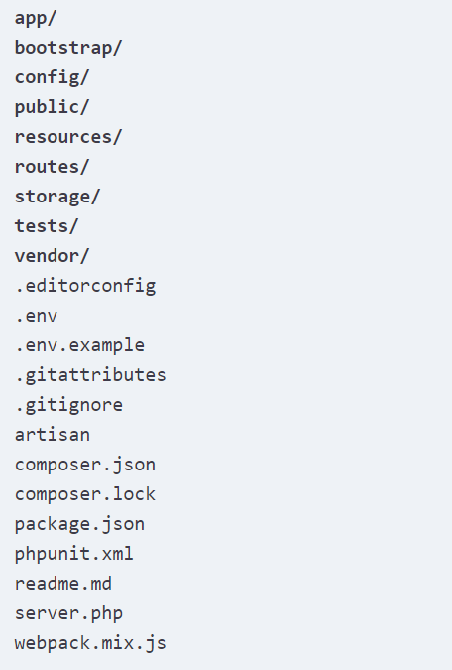
Laravel’s Directory Structure
Copyright © 2022 by Elephant Scale, All Rights Reserved
Notes:
When you open up a directory that contains a skeleton Laravel application, you’ll see the following files and directories:

Slide 29
The Folders
The root directory contains the following folders by default:
app
bootstrap
config
database
public
resources
routes
Storage
tests
vendor
Copyright © 2022 by Elephant Scale, All Rights Reserved
Notes:
app
Where the bulk of your actual application will go. Models, controllers, commands, and your PHP domain code all go in here.
bootstrap
Contains the files that the Laravel framework uses to boot every time it runs.
config
Where all the configuration files live.
database
Where database migrations, seeds, and factories live.
public
The directory the server points to when it’s serving the website. This contains index.php, which is the front controller that kicks off the bootstrapping process and routes all requests appropriately. It’s also where any public-facing files like images, stylesheets, scripts, or downloads go.
resources
Where files that are needed for other scripts live. Views, language files, and (optionally) Sass/Less/source CSS and source JavaScript files live here.
routes
Where all of the route definitions live, both for HTTP routes and “console routes,” or Artisan commands.
storage
Where caches, logs, and compiled system files live.
tests
Where unit and integration tests live.
vendor
Where Composer installs its dependencies. It’s Git-ignored (marked to be excluded from your version control system), as Composer is expected to run as a part of your deploy process on any remote servers.

Slide 30
The Loose Files
The root directory also contains the following files:
.editorconfig
.env and .env.example
.gitignore and .gitattributes
artisan
composer.json and composer.lock
package.json
phpunit.xml
readme.md
server.php
webpack.mix.js
Copyright © 2022 by Elephant Scale, All Rights Reserved
Notes:
.editorconfig
Gives your IDE/text editor instructions about Laravel’s coding standars (e.g., the size of indents, the charset, and whether to trim trailing whitespace). You’ll see this in any Laravel apps running 5.5 and later.
.env and .env.example
Dictate the environment variables (variables that are expected to be different in each environment and are therefore not committed to version control). .env.example is a template that each environment should duplicate to create its own .env file, which is Git-ignored.
.gitignore and .gitattributes
Git configuration files.
artisan
Allows you to run Artisan commands (see lesson 8) from the command line.
composer.json and composer.lock
Configuration files for Composer; composer.json is user-editable and composer.lock is not. These files share some basic information about the project and also define its PHP dependencies.
package.json
Like composer.json but for frontend assets and dependencies of the build system; it instructs NPM on which JavaScript-based dependencies to pull in.
phpunit.xml
A configuration file for PHPUnit, the tool Laravel uses for testing out of the box.
readme.md
A Markdown file giving a basic introduction to Laravel. You won’t see this file if you use the Laravel installer.
server.php
A backup server that tries to allow less-capable servers to still preview the Laravel application.
webpack.mix.js
The (optional) configuration file for Mix. If you’re using Elixir, you’ll instead see gulpfile.js. These files are for giving your build system directions on how to compile and process your frontend assets.

Slide 31
Configuration
If you create a file at config/services.php that looks like this:
// config/services.php
<?php
return [
'sparkpost' => [
'secret' => 'abcdefg',
],
];
you can access that config variable using config('services.sparkpost.secret').
Copyright © 2022 by Elephant Scale, All Rights Reserved
Notes:
The core settings of your Laravel application—database connection settings, queue and mail settings, etc.—live in files in the config folder.
Each of these files returns a PHP array, and each value in the array is accessible by a config key that is comprised of the filename and all descendant keys, separated by dots (.).

Slide 32
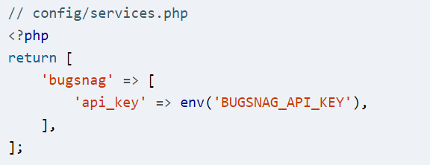
Configuration
Any configuration variables that should be distinct for each environment (and therefore not committed to source control) will instead live in your .env files.
Let’s say you want to use a different Bugsnag API key for each environment.
You’d set the config file to pull it from .env:
Copyright © 2022 by Elephant Scale, All Rights Reserved
Notes:
This env() helper function pulls a value from your .env file with that same key.

Slide 33
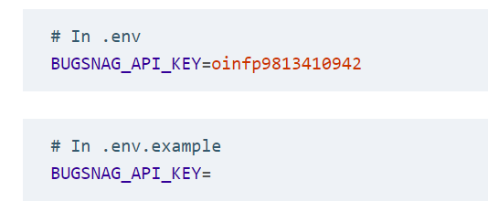
Configuration
Add that key to your .env (settings for this environment) and .env.example (template for all environments) files:
Copyright © 2022 by Elephant Scale, All Rights Reserved
Notes:
Your .env file will already contain quite a few environment-specific variables needed by the framework, like which mail driver you’ll be using and what your basic database settings are.
USING ENV() OUTSIDE OF CONFIG FILES
Certain features in Laravel, including some caching and optimization features, aren’t available if you use env() calls anywhere outside of config files.

Slide 34
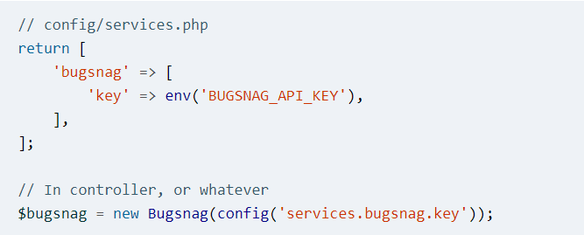
Configuration
config items read the environment variables, and then reference the config variables anywhere within your app:
Copyright © 2022 by Elephant Scale, All Rights Reserved
Notes:
The best way to pull in environment variables is to set up config items for anything you want to be environment-specific.

Slide 35
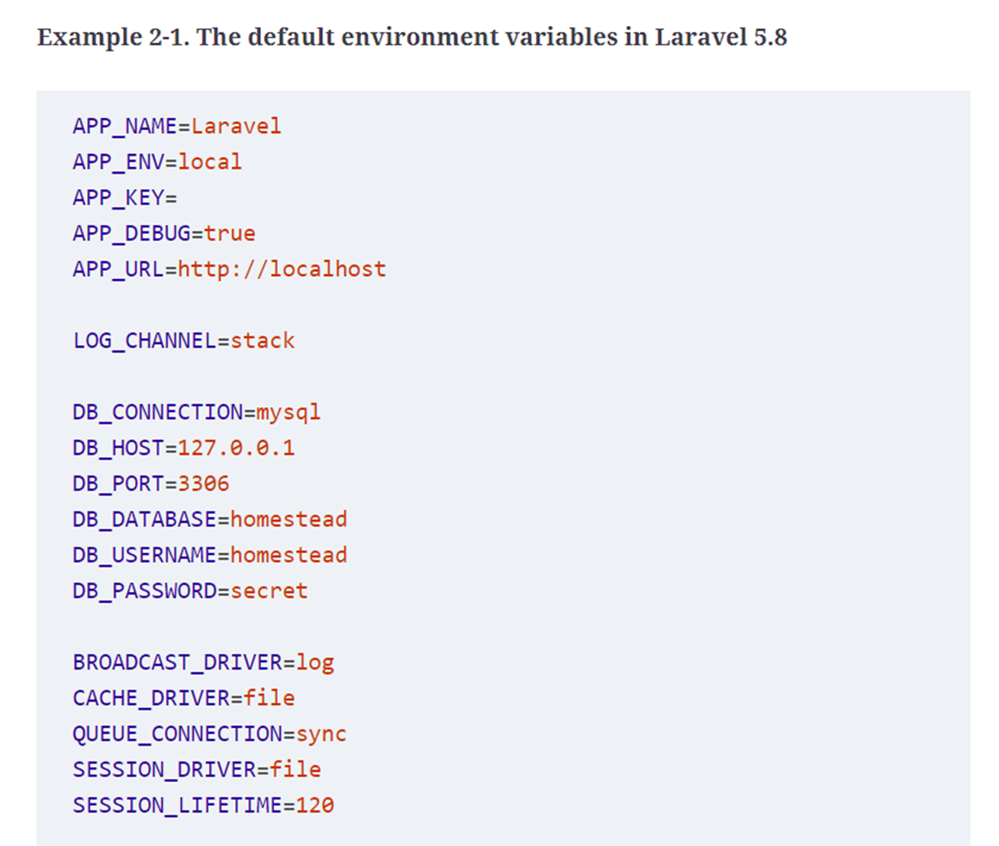
The .env File
Copyright © 2022 by Elephant Scale, All Rights Reserved
Notes:
Let’s take a quick look at the default contents of the .env file. The exact keys will vary depending on which version of Laravel you’re using, but take a look at Example 2-1 to see what they look like in 5.8.

Slide 36
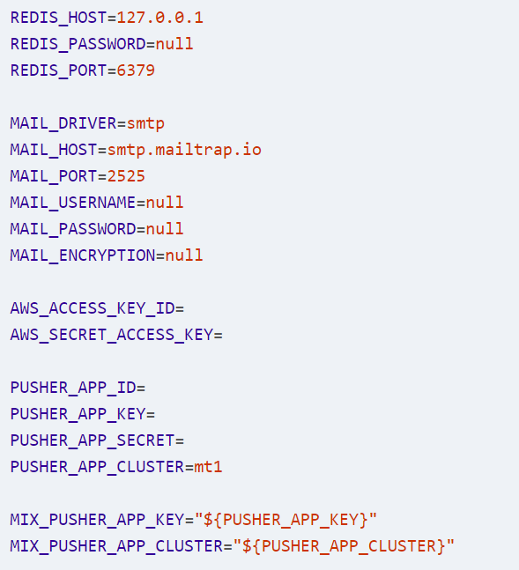
The .env File (Continue)
Copyright © 2022 by Elephant Scale, All Rights Reserved
Notes:
I won’t go into all of them, because quite a few are just groups of authentication information for various services (Pusher, Redis, DB, Mail). Here are two important environment variables you should know about, though:
APP_KEYA randomly generated string that’s used to encrypt data. If this is ever empty, you may run into the error “No application encryption key has been specified.” In that case, just run php artisan key:generate and Laravel will generate one for you.
APP_DEBUGA Boolean determining whether the users of this instance of your application should see debug errors—great for local and staging environments, terrible for production.
The rest of the non-authentication settings (BROADCAST_DRIVER, QUEUE_CONNECTION, etc.) are given default values that work with as little reliance on external services as possible, which is perfect for when you’re getting started.

Slide 37
The .env File
When you start your first Laravel app, the only change you’ll likely want to make for most projects is to the database configuration settings.
I use Laravel Valet, so I change DB_DATABASE to the name of my project, DB_USERNAME to root, and DB_PASSWORD to an empty string:
DB_DATABASE=myProject
DB_USERNAME=root
DB_PASSWORD=
Copyright © 2022 by Elephant Scale, All Rights Reserved
Notes:
Then, I create a database with the same name as my project in my favorite MySQL client, and I’m ready to go.

Slide 38
Up and Running
You’re now up and running with a bare Laravel install.
Run git init, commit the bare files with git add . and git commit, and you’re ready to start coding.
That’s it! And if you’re using Valet, you can run the following commands and instantly see your site live in your browser:
laravel new myProject && cd myProject && valet open
Copyright © 2022 by Elephant Scale, All Rights Reserved

Slide 39
Up and Running
Every time I start a new project, these are the steps I take:
laravel new myProject
cd myProject
git init
git add .
git commit -m "Initial commit"
Copyright © 2022 by Elephant Scale, All Rights Reserved
Notes:
I keep all of my sites in a ~/Sites folder, which I have set up as my primary Valet directory, so in this case I’d instantly have myProject.test accessible in my browser with no added work. I can edit .env and point it to a particular database, add that database in my MySQL app, and I’m ready to start coding. And remember, if you use Lambo, all of these steps are already taken for you.

Slide 40
Testing
In every lesson after this, the “Testing” section at the end of the lesson will show you how to write tests for the feature or features that were covered.
Since this lesson doesn’t cover a testable feature, let’s talk tests quickly. (To learn more about writing and running tests in Laravel, head over to lesson 12.)
Out of the box, Laravel brings in PHPUnit as a dependency and is configured to run the tests in any file in the tests directory whose name ends with Test.php (for example, tests/UserTest.php).
Copyright © 2022 by Elephant Scale, All Rights Reserved
Notes:
So, the simplest way to write tests is to create a file in the tests directory with a name that ends with Test.php. And the easiest way to run them is to run ./vendor/bin/phpunit from the command line (in the project root).
If any tests require database access, be sure to run your tests from the machine where your database is hosted—so if you’re hosting your database in Vagrant, make sure to ssh into your Vagrant box to run your tests from there. Again, you can learn about this and much more in lesson 12.
Also, some of the testing sections will use testing syntax and features that you will not be familiar with yet if you’re reading the course for the first time. If code in any of the testing sections is confusing, just skip it and come back to it after you’ve had a chance to read the testing lesson.

Slide 41
TL;DR
Since Laravel is a PHP framework, it’s very simple to serve it locally.
Laravel also provides two tools for managing your local development: a simpler tool called Valet that uses your local machine to provide your dependencies, and a preconfigured Vagrant setup named Homestead.
Laravel relies on and can be installed by Composer and comes out of the box with a series of folders and files that reflect both its conventions and its relationship with other open source tools.
Copyright © 2022 by Elephant Scale, All Rights Reserved

Slide 42
Routing and Controllers
Copyright © 2022 by Elephant Scale, All Rights Reserved

Slide 43
Routing and Controllers
The essential function of any web application framework is to take requests from a user and deliver responses, usually via HTTP(S).
This means defining an application’s routes is the first and most important project to tackle when learning a web framework; without routes, you have little to no ability to interact with the end user.
Copyright © 2022 by Elephant Scale, All Rights Reserved
Notes:
In this lesson we will examine routes in Laravel; you’ll see how to define them, how to point them to the code they should execute, and how to use Laravel’s routing tools to handle a diverse array of routing needs.

Slide 44
A Quick Introduction to MVC, the HTTP Verbs, and REST
Most of what we’ll talk about in this lesson references how Model–View–Controller (MVC) applications are structured, and many of the examples we’ll be looking at use REST-ish route names and verbs
so let’s take a quick look at both.
Copyright © 2022 by Elephant Scale, All Rights Reserved

Slide 45
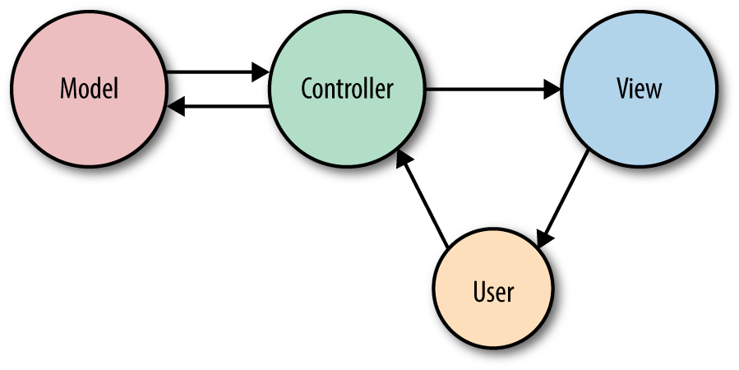
What Is MVC?
In MVC, you have three primary concepts:
Copyright © 2022 by Elephant Scale, All Rights Reserved
Notes:
What Is MVC?
In MVC, you have three primary concepts:
modelRepresents an individual database table (or a record from that table)—think “Company” or “Dog.”
viewRepresents the template that outputs your data to the end user—think “the login page template with this given set of HTML and CSS and JavaScript.”
controllerLike a traffic cop, takes HTTP requests from the browser, gets the right data out of the database and other storage mechanisms, validates user input, and eventually sends a response back to the user.
In Figure 3-1, you can see that the end user will first interact with the controller by sending an HTTP request using their browser. The controller, in response to that request, may write data to and/or pull data from the model (database). The controller will then likely send data to a view, and then the view will be returned to the end user to display in their browser.
We’ll cover some use cases for Laravel that don’t fit this relatively simplistic way of looking at application architecture, so don’t get hung up on MVC, but this will at least get you ready to approach the rest of this lesson as we talk about views and controllers.

Slide 46
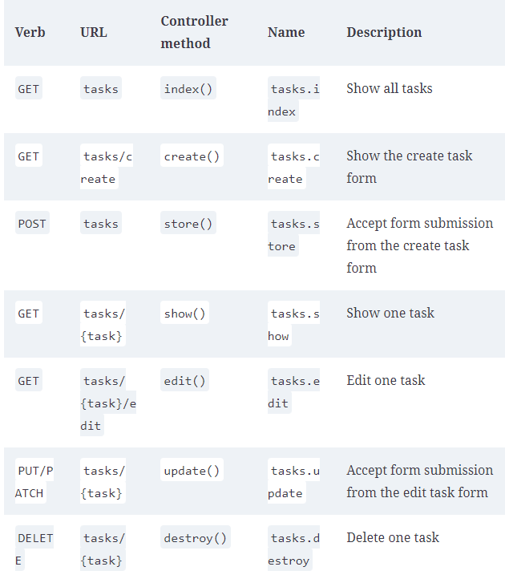
The HTTP Verbs
Copyright © 2022 by Elephant Scale, All Rights Reserved
Notes:
The most common HTTP verbs are GET and POST, followed by PUT and DELETE. There are also HEAD, OPTIONS, and PATCH, and two others that are pretty much never used in normal web development, TRACE and CONNECT.
Here’s a quick rundown:
GET
Request a resource (or a list of resources).
HEAD
Ask for a headers-only version of the GET response.
POST
Create a resource.
PUT
Overwrite a resource.
PATCH
Modify a resource.
DELETE
Delete a resource.
OPTIONS
Ask the server which verbs are allowed at this URL.
Table 3-1 shows the actions available on a resource controller (more on these in “Resource Controllers”). Each action expects you to call a specific URL pattern using a specific verb, so you can get a sense of what each verb is used for.

Slide 47
What Is REST?
We’ll cover REST in greater detail in “The Basics of REST-Like JSON APIs”, but as a brief introduction, it’s an architectural style for building APIs.
When we talk about REST in this course, we’ll mainly be referencing a few characteristics, such as:
Being structured around one primary resource at a time (e.g., tasks)
Consisting of interactions with predictable URL structures using HTTP verbs
Returning JSON and often being requested with JSON
Copyright © 2022 by Elephant Scale, All Rights Reserved
Notes:
There’s more to it, but usually “RESTful” as it’ll be used in this course will mean “patterned after these URL-based structures so we can make predictable calls like GET /tasks/14/edit for the edit page.” This is relevant (even when not building APIs) because Laravel’s routing structures are based around a REST-like structure, as you can see in Table 3-1.
REST-based APIs follow mainly this same structure, except they don’t have a create route or an edit route, since APIs just represent actions, not pages that prep for the actions

Slide 48
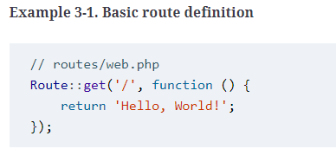
Route Definitions
The simplest way to define a route is to match a path (e.g., /) with a closure, as seen in Example 3-1.
Copyright © 2022 by Elephant Scale, All Rights Reserved
Notes:
In a Laravel application, you will define your web routes in routes/web.php and your API routes in routes/api.php. Web routes are those that will be visited by your end users; API routes are those for your API, if you have one. For now, we’ll primarily focus on the routes in routes/web.php.
ROUTES FILE LOCATION IN LARAVEL PRIOR TO 5.3
In projects running versions of Laravel prior to 5.3, there will be only one routes file, located at app/Http/routes.php.
WHAT’S A CLOSURE?
Closures are PHP’s version of anonymous functions. A closure is a function that you can pass around as an object, assign to a variable, pass as a parameter to other functions and methods, or even serialize.
You’ve now defined that if anyone visits / (the root of your domain), Laravel’s router should run the closure defined there and return the result. Note that we return our content and don’t echo or print it.
A QUICK INTRODUCTION TO MIDDLEWARE
You might be wondering, “Why am I returning ‘Hello, World!’ instead of echoing it?”
There are quite a few answers, but the simplest is that there are a lot of wrappers around Laravel’s request and response cycle, including something called middleware. When your route closure or controller method is done, it’s not time to send the output to the browser yet; returning the content allows it to continue flowing through the response stack and the middleware before it is returned back to the user.

Slide 49
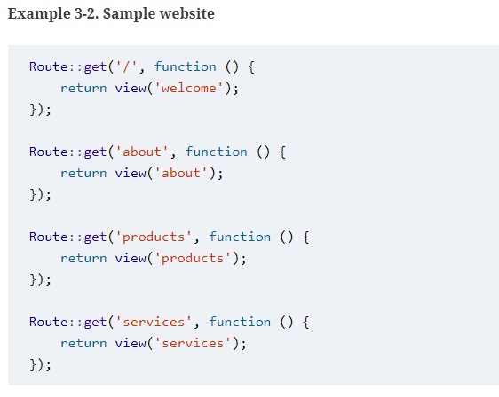
Route Definitions
Copyright © 2022 by Elephant Scale, All Rights Reserved
Notes:
Many simple websites could be defined entirely within the web routes file. With a few simple GET routes combined with some templates, as illustrated in Example 3-2, you can serve a classic website easily.

Slide 50
Route Definitions
If you prefer to avoid facades, you can accomplish these same definitions like this:
$router->get('/', function () {
return 'Hello, World!';
});
Copyright © 2022 by Elephant Scale, All Rights Reserved
Notes:
STATIC CALLS
If you have much experience developing with PHP, you might be surprised to see static calls on the Route class. This is not actually a static method per se, but rather service location using Laravel’s facades, which we’ll cover in lesson 11.

Slide 51
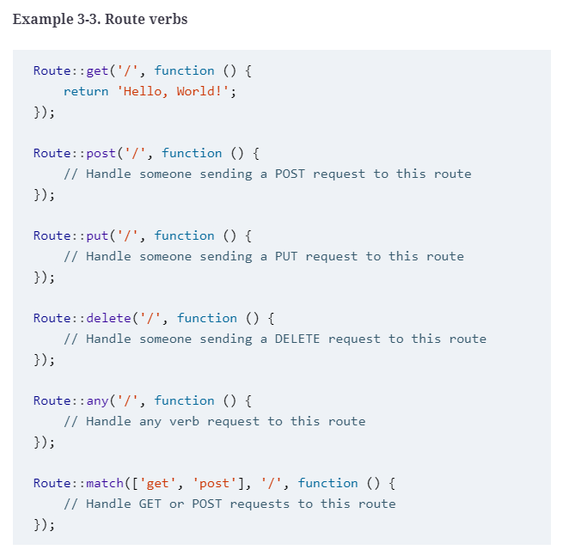
Route Verbs
Copyright © 2022 by Elephant Scale, All Rights Reserved
Notes:
You might’ve noticed that we’ve been using Route::get() in our route definitions. This means we’re telling Laravel to only match for these routes when the HTTP request uses the GET action. But what if it’s a form POST, or maybe some JavaScript sending PUT or DELETE requests? There are a few other options for methods to call on a route definition, as illustrated in Example 3-3.

Slide 52
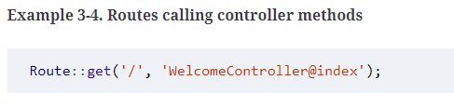
Route Handling
The other common option is to pass a controller name and method as a string in place of the closure, as in Example 3-4.
Copyright © 2022 by Elephant Scale, All Rights Reserved
Notes:
As you’ve probably guessed, passing a closure to the route definition is not the only way to teach it how to resolve a route. Closures are quick and simple, but the larger your application gets, the clumsier it becomes to put all of your routing logic in one file. Additionally, applications using route closures can’t take advantage of Laravel’s route caching (more on that later), which can shave up to hundreds of milliseconds off of each request.
This is telling Laravel to pass requests to that path to the index() method of the App\Http\Controllers\WelcomeController controller. This method will be passed the same parameters and treated the same way as a closure you might’ve alternatively put in its place.
LARAVEL’S CONTROLLER/METHOD REFERENCE SYNTAX
Laravel has a convention for how to refer to a particular method in a given controller: ControllerName@methodName. Sometimes this is just a casual communication convention, but it’s also used in real bindings, like in Example 3-4. Laravel parses what’s before and after the @ and uses those segments to identify the controller and method. Laravel 5.7 also introduced the “tuple” syntax (Route::get('/', [WelcomeController::class, 'index'])) but it’s still common to use ControllerName@methodName to describe a method in written communication.

Slide 53
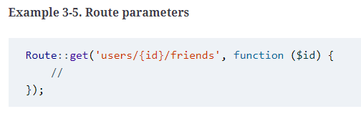
Route Parameters
If the route you’re defining has parameters—segments in the URL structure that are variable—it’s simple to define them in your route and pass them to your closure (see Example 3-5).
Copyright © 2022 by Elephant Scale, All Rights Reserved

Slide 54
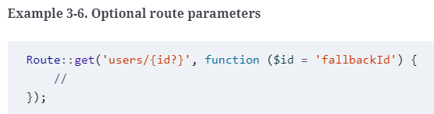
Route Parameters
You can also make your route parameters optional by including a question mark (?) after the parameter name, as illustrated in Example 3-6.
In this case, you should also provide a default value for the route’s corresponding variable.
Copyright © 2022 by Elephant Scale, All Rights Reserved

Slide 55
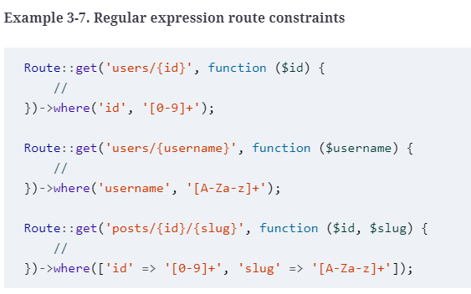
Route Parameters
Copyright © 2022 by Elephant Scale, All Rights Reserved
Notes:
you can use regular expressions (regexes) to define that a route should only match if a parameter meets particular requirements, as in Example 3-7.
As you’ve probably guessed, if you visit a path that matches a route string but the regex doesn’t match the parameter, it won’t be matched. Since routes are matched top to bottom, users/abc would skip the first closure in Example 3-7, but it would be matched by the second closure, so it would get routed there. On the other hand, posts/abc/123 wouldn’t match any of the closures, so it would return a 404 (Not Found) error.
THE NAMING RELATIONSHIP BETWEEN ROUTE PARAMETERS AND CLOSURE/CONTROLLER METHOD PARAMETERS
As you can see in Example 3-5, it’s most common to use the same names for your route parameters ({id}) and the method parameters they inject into your route definition (function ($id)). But is this necessary?

Slide 56
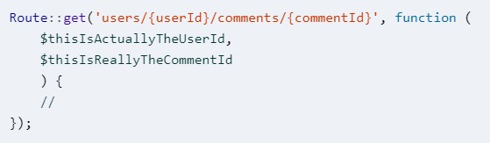
Route Parameters
Unless you’re using route model binding, discussed later in this lesson, no.
The only thing that defines which route parameter matches with which method parameter is their order (left to right), as you can see here:
Copyright © 2022 by Elephant Scale, All Rights Reserved
Notes:
That having been said, just because you can make them different doesn’t mean you should. I recommend keeping them the same for the sake of future developers, who could get tripped up by inconsistent naming.

Slide 57
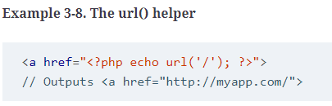
Route Names
The simplest way to refer to these routes elsewhere in your application is just by their path.
There’s a url() global helper to simplify that linking in your views, if you need it; see Example 3-8 for an example.
The helper will prefix your route with the full domain of your site.
Copyright © 2022 by Elephant Scale, All Rights Reserved

Slide 58
Route Names
Example 3-9. Defining route names
// Defining a route with name() in routes/web.php:
Route::get('members/{id}', 'MemberController@show')->name('members.show');
// Linking the route in a view using the route() helper:
<a href="<?php echo route('members.show', ['id' => 14]); ?>">
Copyright © 2022 by Elephant Scale, All Rights Reserved
Notes:
However, Laravel also allows you to name each route, which enables you to refer to it without explicitly referencing the URL. This is helpful because it means you can give simple nicknames to complex routes, and also because linking them by name means you don’t have to rewrite your frontend links if the paths change (see Example 3-9).
This example illustrates a few new concepts. First, we’re using fluent route definition to add the name, by chaining the name() method after the get() method. This method allows us to name the route, giving it a short alias to make it easier to reference elsewhere.

Slide 59
Route Names
Fluent route definitions don’t exist in Laravel 5.1.
You’ll need to instead pass an array to the second parameter of your route definition; check the Laravel docs to see more about how this works.
Here’s Example 3-9 in Laravel 5.1:
Route::get('members/{id}', [
'as' => 'members.show',
'uses' => 'MemberController@show',
]);
Copyright © 2022 by Elephant Scale, All Rights Reserved
Notes:
In our example, we’ve named this route members.show; resourcePlural.action is a common convention within Laravel for route and view names.

Slide 60
Route Names
You can name your route anything you’d like, but the common convention is to use the plural of the resource name, then a period, then the action. So, here are the routes most common for a resource named photo:
photos.index
photos.create
photos.store
photos.show
photos.edit
photos.update
photos.destroy
Copyright © 2022 by Elephant Scale, All Rights Reserved
Notes:
To learn more about these conventions, see “Resource Controllers”.
This example also introduced the route() helper. Just like url(), it’s intended to be used in views to simplify linking to a named route. If the route has no parameters, you can simply pass the route name (route('members.index')) and receive a route string (http://myapp.com/members). If it has parameters, pass them in as an array as the second parameter like we did in Example 3-9.
In general, I recommend using route names instead of paths to refer to your routes, and therefore using the route() helper instead of the url() helper. Sometimes it can get a bit clumsy—for example, if you’re working with multiple subdomains—but it provides an incredible level of flexibility to later change the application’s routing structure without major penalty.

Slide 61
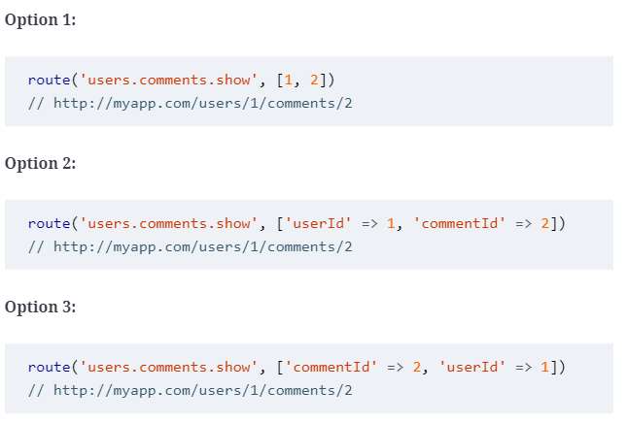
Route Names
Copyright © 2022 by Elephant Scale, All Rights Reserved
Notes:
PASSING ROUTE PARAMETERS TO THE ROUTE() HELPER
When your route has parameters (e.g., users/id), you need to define those parameters when you’re using the route() helper to generate a link to the route.
There are a few different ways to pass these parameters. Let’s imagine a route defined as users/userId/comments/commentId. If the user ID is 1 and the comment ID is 2, let’s look at a few options we have available to us:

Slide 62
Route Names
Option 4:
route('users.comments.show', ['userId' => 1, 'commentId' => 2, 'opt' => 'a'])
// http://myapp.com/users/1/comments/2?opt=a
Copyright © 2022 by Elephant Scale, All Rights Reserved
Notes:
As you can see, nonkeyed array values are assigned in order; keyed array values are matched with the route parameters matching their keys, and anything left over is added as a query parameter.

Slide 63
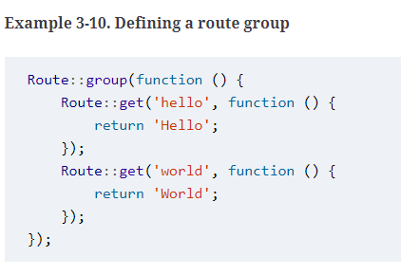
Route Groups
Copyright © 2022 by Elephant Scale, All Rights Reserved
Notes:
Often a group of routes share a particular characteristic—a certain authentication requirement, a path prefix, or perhaps a controller namespace. Defining these shared characteristics again and again on each route not only seems tedious but also can muddy up the shape of your routes file and obscure some of the structures of your application.
Route groups allow you to group several routes together and apply any shared configuration settings once to the entire group, to reduce this duplication. Additionally, route groups are visual cues to future developers (and to your own brain) that these routes are grouped together.
To group two or more routes together, you “surround” the route definitions with a route group, as shown in Example 3-10. In reality, you’re actually passing a closure to the group definition, and defining the grouped routes within that closure.
By default, a route group doesn’t actually do anything. There’s no difference between using the group in Example 3-10 and separating a segment of your routes with code comments.

Slide 64
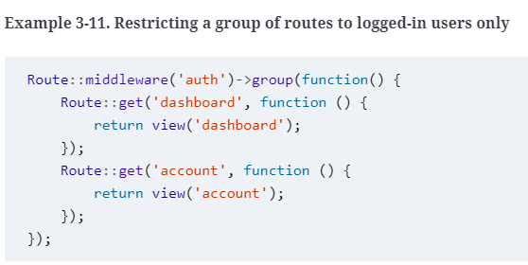
Middleware
Copyright © 2022 by Elephant Scale, All Rights Reserved
Notes:
Probably the most common use for route groups is to apply middleware to a group of routes. You’ll learn more about middleware in lesson 10, but, among other things, they’re what Laravel uses for authenticating users and restricting guest users from using certain parts of a site.
In Example 3-11, we’re creating a route group around the dashboard and account views and applying the auth middleware to both. In this example, this means users have to be logged in to the application to view the dashboard or the account page.

Slide 65
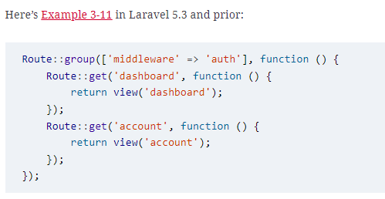
Middleware
Copyright © 2022 by Elephant Scale, All Rights Reserved
Notes:
MODIFYING ROUTE GROUPS PRIOR TO LARAVEL 5.4
Just like fluent route definition didn’t exist in Laravel prior to 5.2, fluently applying modifiers like middleware, prefixes, domains, and more to route groups wasn’t possible prior to 5.4.

Slide 66
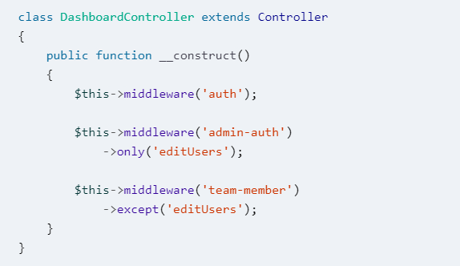
Applying middleware in controllers
The string you pass to the middleware() method is the name of the middleware, and you can optionally chain modifier methods (only() and except()) to define which methods will receive that middleware:
Copyright © 2022 by Elephant Scale, All Rights Reserved
Notes:
Often it’s clearer and more direct to attach middleware to your routes in the controller instead of at the route definition. You can do this by calling the middleware() method in the constructor of your controller.
Note that if you’re doing a lot of “only” and “except” customizations, that’s often a sign that you should break out a new controller for the exceptional routes.

Slide 67
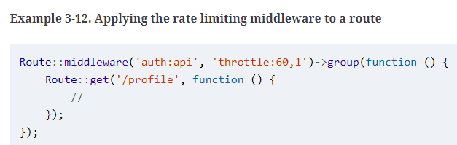
Rate limiting
Apply the throttle middleware, which takes two parameters: the first is the number of tries a user is permitted and the second is the number of minutes to wait before resetting the attempt count. Example 3-12 demonstrates its use.
Copyright © 2022 by Elephant Scale, All Rights Reserved
Notes:
If you need to limit users to only be able to access any given route(s) a certain number of times in a given time frame (called rate limiting, and most common with APIs), there’s an out-of-the-box middleware for that in version 5.2 and above.
If you’d like to differentiate one user’s rate limit from another’s, you can instruct the throttle middleware to pull the tries count (its first parameter) from the user’s Eloquent model. Instead of passing a tries count as the first parameter of throttle, instead pass the name of an attribute on the Eloquent model, and that attribute will be used to calculate whether the user has passed their rate limit.
So, if your user model has a plan_rate_limit attribute on it, you could use the middleware with throttle:plan_rate_limit,1.
A BRIEF INTRODUCTION TO ELOQUENT
We’ll be covering Eloquent, database access, and Laravel’s query builder in depth in lesson 5, but there will be a few references between now and then that will make a basic understanding useful.
Eloquent is Laravel’s ActiveRecord database object-relational mapper (ORM), which makes it easy to relate a Post class (model) to the posts database table and get all records with a call like Post::all().
The query builder is the tool that makes it possible to make calls like Post::where('active', true)->get() or even DB::table('users')->all(). You’re building a query by chaining methods one after another.

Slide 68
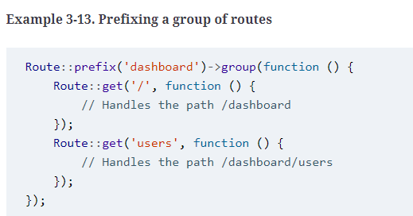
Path Prefixes
If you have a group of routes that share a segment of their path—for example, if your site’s dashboard is prefixed with /dashboard—you can use route groups to simplify this structure (see Example 3-13).
Copyright © 2022 by Elephant Scale, All Rights Reserved
Notes:
Note that each prefixed group also has a / route that represents the root of the prefix—in Example 3-13 that’s /dashboard.

Slide 69
Fallback Routes
In Laravel prior to 5.6, you could define a “fallback route” (which you need to define at the end of your routes file) to catch all unmatched paths:
Route::any('{anything}', 'CatchAllController')->where('anything', '*’);
In Laravel 5.6+, you can use the Route::fallback() method instead:
Route::fallback(function () {
//
});
Copyright © 2022 by Elephant Scale, All Rights Reserved

Slide 70
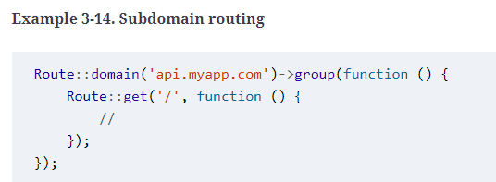
Subdomain Routing
Subdomain routing is the same as route prefixing, but it’s scoped by subdomain instead of route prefix.
There are two primary uses for this. First, you may want to present different sections of the application (or entirely different applications) to different subdomains. Example 3-14 shows how you can achieve this.
Copyright © 2022 by Elephant Scale, All Rights Reserved

Slide 71
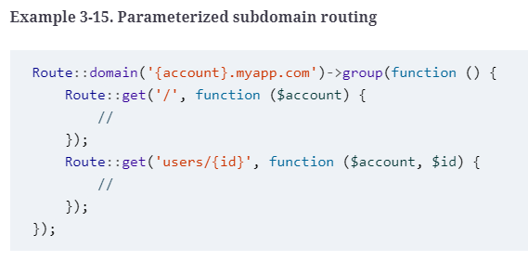
Subdomain Routing
Copyright © 2022 by Elephant Scale, All Rights Reserved
Notes:
Second, you might want to set part of the subdomain as a parameter, as illustrated in Example 3-15. This is most often done in cases of multitenancy (think Slack or Harvest, where each company gets its own subdomain, like tighten.slack.co).
Note that any parameters for the group get passed into the grouped routes’ methods as the first parameter(s).

Slide 72
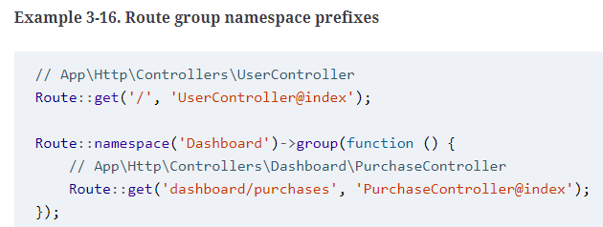
Namespace Prefixes
Copyright © 2022 by Elephant Scale, All Rights Reserved
Notes:
When you’re grouping routes by subdomain or route prefix, it’s likely their controllers have a similar PHP namespace. In the dashboard example, all of the dashboard routes’ controllers might be under a Dashboard namespace. By using the route group namespace prefix, as shown in Example 3-16, you can avoid long controller references in groups like "Dashboard/UserController@index" and "Dashboard/PurchaseController@index".

Slide 73
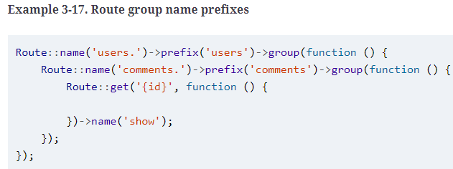
Name Prefixes
Just like we can prefix URL segments and controller namespaces, we can also prefix strings to the route name. With route group name prefixes, we can define that every route within this group should have a given string prefixed to its name.
In this context, we’re prefixing "users." to each route name, then "comments." (see Example 3-17).
Copyright © 2022 by Elephant Scale, All Rights Reserved
Notes:
The prefixes don’t stop there. It’s common that route names will reflect the inheritance chain of path elements, so users/comments/5 will be served by a route named users.comments.show. In this case, it’s common to use a route group around all of the routes that are beneath the users.comments resource.
Signed Routes
Many applications regularly send notifications about one-off actions (resetting a password, accepting an invitation, etc.) and provide simple links to take those actions. Let’s imagine sending an email confirming the recipient was willing to be added to a mailing list.
There are three ways to send that link:
Make that URL public and hope no one else discovers the approval URL or modifies their own approval URL to approve someone else.
Put the action behind authentication, link to the action, and require the user to log in if they’re not logged in yet (which, in this case, may be impossible, as many mailing list recipients likely won’t be users).
“Sign” the link so that it uniquely proves that the user received the link from your email, without them having to log in; something like http://myapp.com/invitations/5816/yes?signature=030ab0ef6a8237bd86a8b8.
One simple way to accomplish the last option is to use a feature introduced in Laravel 5.6.12 called signed URLs, which makes it easy to build a signature authentication system for sending out authenticated links. These links are composed of the normal route link with a “signature” appended that proves that the URL has not been changed since it was sent (and therefore that no one has modified the URL to access someone else’s information).

Slide 74
Signing a Route
In order to build a signed URL to access a given route, the route must have a name:
Route::get('invitations/{invitation}/{answer}', 'InvitationController')
->name('invitations');
Copyright © 2022 by Elephant Scale, All Rights Reserved

Slide 75
Signing a Route
// Generate a normal link
URL::route('invitations', ['invitation' => 12345, 'answer' => 'yes']);
// Generate a signed link
URL::signedRoute('invitations', ['invitation' => 12345, 'answer' => 'yes']);
// Generate an expiring (temporary) signed link
URL::temporarySignedRoute(
'invitations',
now()->addHours(4),
['invitation' => 12345, 'answer' => 'yes']
);
Copyright © 2022 by Elephant Scale, All Rights Reserved
Notes:
To generate a normal link to this route you would use the route() helper, as we’ve already covered, but you could also use the URL facade to do the same thing: URL::route('invitations', ['invitation' => 12345, 'answer' => 'yes']). To generate a signed link to this route, simply use the signedRoute() method instead. And if you want to generate a signed route with an expiration, use temporarySignedRoute():
USING THE NOW() HELPER
Since version 5.5 Laravel has offered a now() helper that’s the equivalent of Carbon::now(); it returns a Carbon object representative of today, right at this second. If you’re working with Laravel prior to 5.5, you can replace any instance of now() in this course with Carbon::now().
Carbon, if you’re not familiar with it, is a datetime library that’s included with Laravel.

Slide 76
Modifying Routes to Allow Signed Links
Now that you’ve generated a link to your signed route, you need to protect against any unsigned access.
The easiest option is to apply the signed middleware (which, if it’s not in your $routeMiddleware array in app/Http/Kernel.php, should be, backed by Illuminate\Routing\Middleware\ValidateSignature):
Route::get('invitations/{invitation}/{answer}', 'InvitationController')
->name('invitations')
->middleware('signed');
Copyright © 2022 by Elephant Scale, All Rights Reserved

Slide 77
Modifying Routes to Allow Signed Links
If you’d prefer, you can manually validate using the hasValidSignature() method on the Request object instead of using the signed middleware:
class InvitationController
{
public function __invoke(Invitation $invitation, $answer, Request $request)
{
if (! $request->hasValidSignature()) {
abort(403);
}
//
}
}
Copyright © 2022 by Elephant Scale, All Rights Reserved

Slide 78
Views
Once you’ve “loaded” a view with the view() helper, you have the option to simply return it (as in Example 3-18), which will work fine if the view doesn’t rely on any variables from the controller.
Example 3-18. Simple view() usage
Route::get('/', function () {
return view('home');
});
Copyright © 2022 by Elephant Scale, All Rights Reserved
Notes:
In a few of the route closures we’ve looked at so far, we’ve seen something along the lines of return view('account'). What’s going on here?
In the MVC pattern (Figure 3-1), views (or templates) are files that describe what some particular output should look like. You might have views for JSON or XML or emails, but the most common views in a web framework output HTML.
In Laravel, there are two formats of view you can use out of the box: plain PHP, or Blade templates (see lesson 4). The difference is in the filename: about.php will be rendered with the PHP engine, and about.blade.php will be rendered with the Blade engine.
THREE WAYS TO LOAD A VIEW
There are three different ways to return a view. For now, just concern yourself with view(), but if you ever see View::make(), it’s the same thing, or you could inject the Illuminate\View\ViewFactory if you prefer.
This code looks for a view in resources/views/home.blade.php or resources/views/home.php, and loads its contents and parses any inline PHP or control structures until you have just the view’s output. Once you return it, it’s passed on to the rest of the response stack and eventually returned to the user.

Slide 79
Views
what if you need to pass in variables? Take a look at Example 3-19.
Example 3-19. Passing variables to views
Route::get('tasks', function () {
return view('tasks.index')
->with('tasks', Task::all());
});
Copyright © 2022 by Elephant Scale, All Rights Reserved
Notes:
This closure loads the resources/views/tasks/index.blade.php or resources/views/tasks/index.php view and passes it a single variable named tasks, which contains the result of the Task::all() method. Task::all() is an Eloquent database query you’ll learn about in lesson 5.

Slide 80
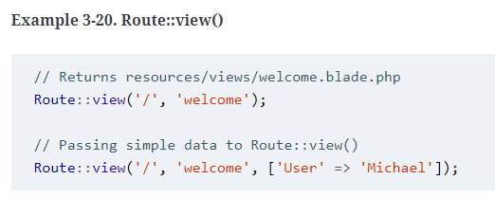
Returning Simple Routes Directly with Route::view()
Because it’s so common for a route to just return a view with no custom data, Laravel 5.5+ allows you to define a route as a “view” route without even passing the route definition a closure or a controller/method reference, as you can see in Example 3-20.
Copyright © 2022 by Elephant Scale, All Rights Reserved

Slide 81
Using View Composers to Share Variables with Every View
Sometimes it can become a hassle to pass the same variables over and over.
There may be a variable that you want accessible to every view in the site, or to a certain class of views or a certain included subview—for example, all views related to tasks, or the header partial.
It’s possible to share certain variables with every template or just certain templates, like in the following code:
view()->share('variableName', 'variableValue');
Copyright © 2022 by Elephant Scale, All Rights Reserved
Notes:
To learn more, check out “View Composers and Service Injection”.

Slide 82
Controllers
Let’s create a controller. One easy way to do this is with an Artisan command, so from the command line run the following:
php artisan make:controller TaskController
Copyright © 2022 by Elephant Scale, All Rights Reserved
Notes:
I’ve mentioned controllers a few times, but until now most of the examples have shown route closures. In the MVC pattern, controllers are essentially classes that organize the logic of one or more routes together in one place. Controllers tend to group similar routes together, especially if your application is structured in a traditionally CRUD-like format; in this case, a controller might handle all the actions that can be performed on a particular resource.
WHAT IS CRUD?
CRUD stands for create, read, update, delete, which are the four primary operations that web applications most commonly provide on a resource. For example, you can create a new blog post, you can read that post, you can update it, or you can delete it.
It may be tempting to cram all of the application’s logic into the controllers, but it’s better to think of controllers as the traffic cops that route HTTP requests around your application. Since there are other ways requests can come into your application—cron jobs, Artisan command-line calls, queue jobs, etc.—it’s wise to not rely on controllers for much behavior. This means a controller’s primary job is to capture the intent of an HTTP request and pass it on to the rest of the application.

Slide 83
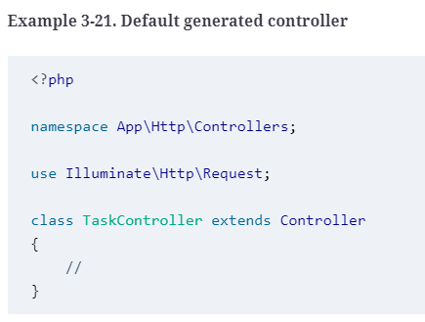
Controllers
Copyright © 2022 by Elephant Scale, All Rights Reserved
Notes:
ARTISAN AND ARTISAN GENERATORS
Laravel comes bundled with a command-line tool called Artisan. Artisan can be used to run migrations, create users and other database records manually, and perform many other manual, one-time tasks.
Under the make namespace, Artisan provides tools for generating skeleton files for a variety of system files. That’s what allows us to run php artisan make:controller.
To learn more about this and other Artisan features, see lesson 8.
This will create a new file named TaskController.php in app/Http/Controllers, with the contents shown in Example 3-21.

Slide 84
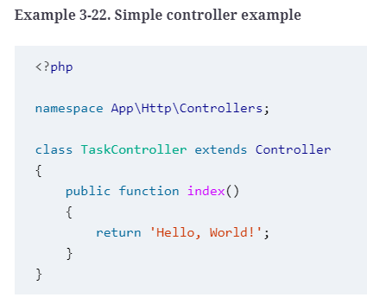
Controllers
Modify this file as shown in Example 3-22, creating a new public method called index(). We’ll just return some text there.
Copyright © 2022 by Elephant Scale, All Rights Reserved

Slide 85
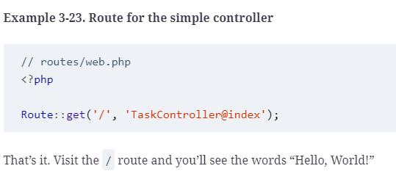
Controllers
Then, like we learned before, we’ll hook up a route to it, as shown in Example 3-23.
Copyright © 2022 by Elephant Scale, All Rights Reserved
Notes:
CONTROLLER NAMESPACING
In Example 3-23 we referenced a controller that has the fully qualified class name of App\Http\Controllers\TaskController, but we only used the class name. This isn’t because we can simply reference controllers by their class name. Rather, we can ignore the App\Http\Controllers\ when we reference controllers; by default, Laravel is configured to look for controllers within that namespace.
This means that if you have a controller with the fully qualified class name of App\Http\Controllers\API\ExerciseController, you’d reference it in a route definition as API\ExerciseController.

Slide 86
Controllers
The most common use of a controller method, then, will be something like Example 3-24, which provides the same functionality as our route closure in Example 3-19.
Example 3-24. Common controller method example
// TaskController.php
...
public function index()
{
return view('tasks.index')
->with('tasks', Task::all());
}
Copyright © 2022 by Elephant Scale, All Rights Reserved
Notes:
This controller method loads the resources/views/tasks/index.blade.php or resources/views/tasks/index.php view and passes it a single variable named tasks, which contains the result of the Task::all() Eloquent method.
GENERATING RESOURCE CONTROLLERS
If you ever used php artisan make:controller in Laravel prior to 5.3, you might be expecting it to autogenerate methods for all of the basic resource routes like create() and update(). You can bring this behavior back in Laravel 5.3+ by passing the --resource flag when you create the controller:
php artisan make:controller TaskController --resource

Slide 87
Getting User Input
First, let’s bind our route; see Example 3-25.
Example 3-25. Binding basic form actions
// routes/web.php
Route::get('tasks/create', 'TaskController@create');
Route::post('tasks', 'TaskController@store');
Copyright © 2022 by Elephant Scale, All Rights Reserved
Notes:
The second most common action to perform in a controller method is to take input from the user and act on it. That introduces a few new concepts, so let’s take a look at a bit of sample code and walk through the new pieces.

Slide 88
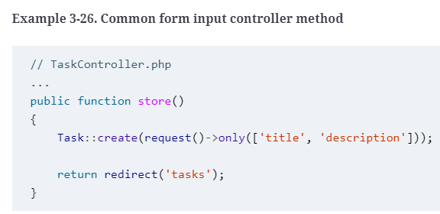
Getting User Input
We can assume the create() method in our controller just shows a form, so let’s look at the store() method in Example 3-26.
Copyright © 2022 by Elephant Scale, All Rights Reserved
Notes:
Notice that we’re binding the GET action of tasks/create (which shows a form for creating a new task) and the POST action of tasks/ (which is where our form will POST to when we’re creating a new task).
This example makes use of Eloquent models and the redirect() functionality, and we’ll talk about them more later, but for now let’s talk quickly about how we’re getting our data here.
We’re using the request() helper to represent the HTTP request (more on that later) and using its only() method to pull just the title and description fields the user submitted.
We’re then passing that data into the create() method of our Task model, which creates a new instance of the Task with title set to the passed-in title and description set to the passed-in description. Finally, we redirect back to the page that shows all tasks.
There are a few layers of abstraction at work here, which we’ll cover in a second, but know that the data coming from the only() method comes from the same pool of data all common methods used on the Request object draw from, including all() and get(). The set of data each of these methods is pulling from represents all user-provided data, whether from query parameters or POST values. So, our user filled out two fields on the “add task” page: “title” and “description.”

Slide 89
Getting User Input
To break down the abstraction a bit, request()->only() takes an associative array of input names and returns them:
request()->only(['title', 'description']);
// returns:
[
'title' => 'Whatever title the user typed on the previous page',
'description' => 'Whatever description the user typed on the previous page',
]
Copyright © 2022 by Elephant Scale, All Rights Reserved

Slide 90
Getting User Input
And Task::create() takes an associative array and creates a new task from it:
Task::create([
'title' => 'Buy milk',
'description' => 'Remember to check the expiration date this time, Norbert!',
]);
Copyright © 2022 by Elephant Scale, All Rights Reserved
Notes:
Combining them together creates a task with just the user-provided “title” and “description” fields.

Slide 91
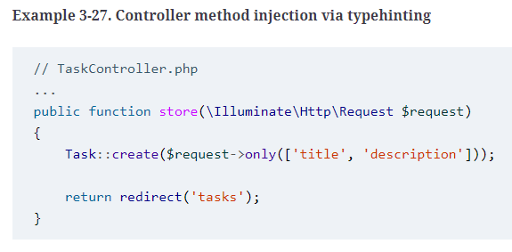
Getting User Input
what if you’d prefer having an instance of the Request object instead of using the global helper? Just typehint Illuminate\Http\Request in your method parameters, like in Example 3-27.
Copyright © 2022 by Elephant Scale, All Rights Reserved
Notes:
Injecting Dependencies into Controllers
Laravel’s facades and global helpers present a simple interface to the most useful classes in Laravel’s codebase. You can get information about the current request and user input, the session, caches, and much more.
But if you prefer to inject your dependencies, or if you want to use a service that doesn’t have a facade or a helper, you’ll need to find some way to bring instances of these classes into your controller.
This is our first exposure to Laravel’s service container. For now, if this is unfamiliar, you can think about it as a little bit of Laravel magic; or, if you want to know more about how it’s actually functioning, you can skip ahead to lesson 11.
All controller methods (including the constructors) are resolved out of Laravel’s container, which means anything you typehint that the container knows how to resolve will be automatically injected.
TYPEHINTS IN PHP
“Typehinting” in PHP means putting the name of a class or interface in front of a variable in a method signature:
public function __construct(Logger $logger) {}
This typehint is telling PHP that whatever is passed into the method must be of type Logger, which could be either an interface or a class.
So, you’ve defined a parameter that must be passed into the store() method. And since you typehinted it, and since Laravel knows how to resolve that class name, you’re going to have the Request object ready for you to use in your method with no work on your part. No explicit binding, no anything else—it’s just there as the $request variable.
And, as you can tell from comparing Example 3-26 and Example 3-27, the request() helper and the Request object behave exactly the same.

Slide 92
Resource Controllers
Sometimes naming the methods in your controllers can be the hardest part of writing a controller.
Thankfully, Laravel has some conventions for all of the routes of a traditional REST/CRUD controller (called a “resource controller” in Laravel); additionally, it comes with a generator out of the box and a convenience route definition that allows you to bind an entire resource controller at once.
To see the methods that Laravel expects for a resource controller, let’s generate a new controller from the command line:
php artisan make:controller MySampleResourceController --resource
Copyright © 2022 by Elephant Scale, All Rights Reserved
Notes:
Now open app/Http/Controllers/MySampleResourceController.php. You’ll see it comes prefilled with quite a few methods. Let’s walk over what each represents. We’ll use a Task as an example.
The methods of Laravel’s resource controllers
Remember the table from earlier? Table 3-1 shows the HTTP verb, the URL, the controller method name, and the name for each of these default methods that are generated in Laravel’s resource controllers.

Slide 93
Binding a resource controller
So, we’ve seen that these are the conventional route names to use in Laravel, and also that it’s easy to generate a resource controller with methods for each of these default routes.
Thankfully, you don’t have to generate routes for each of these controller methods by hand, if you don’t want to.
There’s a trick for that, called resource controller binding. Take a look at Example 3-28.
Example 3-28. Resource controller binding
// routes/web.php
Route::resource('tasks', 'TaskController');
Copyright © 2022 by Elephant Scale, All Rights Reserved
Notes:
This will automatically bind all of the routes listed in Table 3-1 for this resource to the appropriate method names on the specified controller. It’ll also name these routes appropriately; for example, the index() method on the tasks resource controller will be named tasks.index.

Slide 94
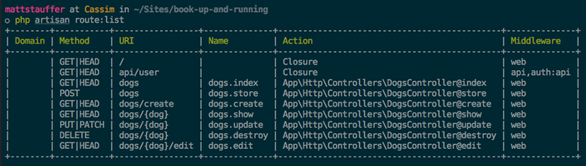
ARTISAN ROUTE:LIST
If you ever find yourself in a situation where you’re wondering what routes your current application has available, there’s a tool for that: from the command line, run php artisan route:list and you’ll get a listing of all of the available routes (see Figure 3-2).
Copyright © 2022 by Elephant Scale, All Rights Reserved

Slide 95
API Resource Controllers
Laravel 5.6 introduced a new way to generate an API resource controller, which has the same structure as a resource controller except it excludes the create and edit actions.
We can generate API resource controllers by passing the --api flag when creating a controller:
php artisan make:controller MySampleResourceController --api
Copyright © 2022 by Elephant Scale, All Rights Reserved
Notes:
When you’re working with RESTful APIs, the list of potential actions on a resource is not the same as it is with an HTML resource controller. For example, you can send a POST request to an API to create a resource, but you can’t really “show a create form” in an API.

Slide 96
Binding an API resource controller
To bind an API resource controller, use the apiResource() method instead of the resource() method, as shown in Example 3-29.
Example 3-29. API resource controller binding
// routes/web.php
Route::apiResource('tasks', 'TaskController');
Copyright © 2022 by Elephant Scale, All Rights Reserved

Slide 97
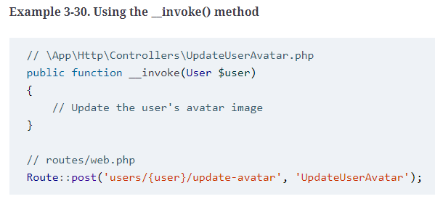
Single Action Controllers
The tool Laravel’s single action controllers use to allow you to point a route to a single controller, as you can see in Example 3-30.
Copyright © 2022 by Elephant Scale, All Rights Reserved
Notes:
There will be times in your applications when a controller should only service a single route. You may find yourself wondering how to name the controller method for that route. Thankfully, you can point a single route at a single controller without concerning yourself with naming the one method.
As you may already know, the __invoke() method is a PHP magic method that allows you to “invoke” an instance of a class, treating it like a function and calling it.

Slide 98
Route Model Binding
One of the most common routing patterns is that the first line of any controller method tries to find the resource with the given ID, like in Example 3-31.
Example 3-31. Getting a resource for each route
Route::get('conferences/{id}', function ($id) {
$conference = Conference::findOrFail($id);
});
Copyright © 2022 by Elephant Scale, All Rights Reserved
Notes:
Laravel provides a feature that simplifies this pattern called route model binding. This allows you to define that a particular parameter name (e.g., {conference}) will indicate to the route resolver that it should look up an Eloquent database record with that ID and then pass it in as the parameter instead of just passing the ID.
There are two kinds of route model binding: implicit and custom (or explicit).

Slide 99
Implicit Route Model Binding
The simplest way to use route model binding is to name your route parameter something unique to that model (e.g., name it $conference instead of $id), then typehint that parameter in the closure/controller method and use the same variable name there.
It’s easier to show than to describe, so take a look at Example 3-32.
Example 3-32. Using an implicit route model binding
Route::get('conferences/{conference}', function (Conference $conference) {
return view('conferences.show')->with('conference', $conference);
});
Copyright © 2022 by Elephant Scale, All Rights Reserved
Notes:
Because the route parameter ({conference}) is the same as the method parameter ($conference), and the method parameter is typehinted with a Conference model (Conference $conference), Laravel sees this as a route model binding. Every time this route is visited, the application will assume that whatever is passed into the URL in place of {conference} is an ID that should be used to look up a Conference, and then that resulting model instance will be passed in to your closure or controller method.
CUSTOMIZING THE ROUTE KEY FOR AN ELOQUENT MODEL
Any time an Eloquent model is looked up via a URL segment (usually because of route model binding), the default column Eloquent will look it up by is its primary key (ID).

Slide 100
Implicit Route Model Binding
To change the column your Eloquent model uses for URL lookups, add a method to your model named getRouteKeyName():
public function getRouteKeyName()
{
return 'slug';
}
Copyright © 2022 by Elephant Scale, All Rights Reserved
Notes:
Now, a URL like conferences/{conference} will expect to get an entry from the slug column instead of the ID, and will perform its lookups accordingly.
Implicit route model binding was added in Laravel 5.2, so you won’t have access to it in 5.1.

Slide 101
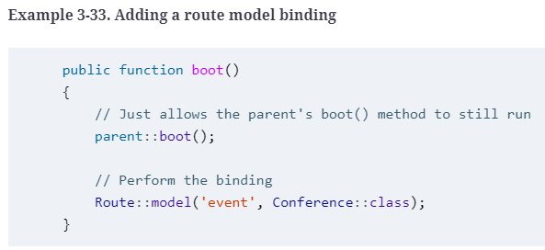
Custom Route Model Binding
To manually configure route model bindings, add a line like the one in Example 3-33 to the boot() method in App\Providers\RouteServiceProvider.
Copyright © 2022 by Elephant Scale, All Rights Reserved

Slide 102
Custom Route Model Binding
You’ve now specified that whenever a route has a parameter in its definition named {event}, as demonstrated in Example 3-34, the route resolver will return an instance of the Conference class with the ID of that URL parameter.
Example 3-34. Using an explicit route model binding
Route::get('events/{event}', function (Conference $event) {
return view('events.show')->with('event', $event);
});
Copyright © 2022 by Elephant Scale, All Rights Reserved

Slide 103
Route Caching
If you’re looking to squeeze every millisecond out of your load time, you may want to take a look at route caching.
One of the pieces of Laravel’s bootstrap that can take anywhere from a few dozen to a few hundred milliseconds is parsing the routes/* files, and route caching speeds up this process dramatically.
To cache your routes file, you need to be using all controller, redirect, view, and resource routes (no route closures).
If your app isn’t using any route closures, you can run php artisan route:cache and Laravel will serialize the results of your routes/* files. If you want to delete the cache, run php artisan route:clear.
Copyright © 2022 by Elephant Scale, All Rights Reserved
Notes:
Here’s the drawback: Laravel will now match routes against that cached file instead of your actual routes/* files. You can make endless changes to your routes files, and they won’t take effect until you run route:cache again. This means you’ll have to recache every time you make a change, which introduces a lot of potential for confusion.
Here’s what I would recommend instead: since Git ignores the route cache file by default anyway, consider only using route caching on your production server, and run the php artisan route:cache command every time you deploy new code (whether via a Git post-deploy hook, a Forge deploy command, or as a part of whatever other deploy system you use). This way you won’t have confusing local development issues, but your remote environment will still benefit from route caching.

Slide 104
Form Method Spoofing
Sometimes you need to manually define which HTTP verb a form should send as.
HTML forms only allow for GET or POST, so if you want any other sort of verb, you’ll need to specify that yourself.
Copyright © 2022 by Elephant Scale, All Rights Reserved
Notes:
HTTP Verbs in Laravel
As we’ve seen already, you can define which verbs a route will match in the route definition using Route::get(), Route::post(), Route::any(), or Route::match(). You can also match with Route::patch(), Route::put(), and Route::delete().
But how does one send a request other than GET with a web browser? First, the method attribute in an HTML form determines its HTTP verb: if your form has a method of "GET", it will submit via query parameters and a GET method; if the form has a method of "POST", it will submit via the post body and a POST method.
JavaScript frameworks make it easy to send other requests, like DELETE and PATCH. But if you find yourself needing to submit HTML forms in Laravel with verbs other than GET or POST, you’ll need to use form method spoofing, which means spoofing the HTTP method in an HTML form.

Slide 105
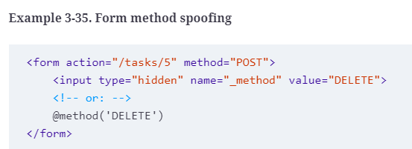
HTTP Method Spoofing in HTML Forms
The form in Example 3-35, since it’s passing Laravel the method of "DELETE", will match routes defined with Route::delete() but not those with Route::post().
Copyright © 2022 by Elephant Scale, All Rights Reserved
Notes:
To inform Laravel that the form you’re currently submitting should be treated as something other than a POST, add a hidden variable named _method with the value of either "PUT", "PATCH", or "DELETE", and Laravel will match and route that form submission as if it were actually a request with that verb.

Slide 106
CSRF Protection
You have two options for getting around this CSRF error.
The first, and preferred, method is to add the _token input to each of your submissions. In HTML forms, that’s simple; look at Example 3-36.
Example 3-36. CSRF tokens
<form action="/tasks/5" method="POST">
<?php echo csrf_field(); ?>
<!-- or: -->
<input type="hidden" name="_token" value="<?php echo csrf_token(); ?>">
<!-- or: -->
@csrf
</form>
Copyright © 2022 by Elephant Scale, All Rights Reserved
Notes:
If you’ve tried to submit a form in a Laravel application already, including the one in Example 3-35, you’ve likely run into the dreaded TokenMismatchException.
By default, all routes in Laravel except “read-only” routes (those using GET, HEAD, or OPTIONS) are protected against cross-site request forgery (CSRF) attacks by requiring a token, in the form of an input named _token, to be passed along with each request. This token is generated at the start of every session, and every non–read-only route compares the submitted _token against the session token.
WHAT IS CSRF?
A cross-site request forgery is when one website pretends to be another. The goal is for someone to hijack your users’ access to your website, by submitting forms from their website to your website via the logged-in user’s browser.
The best way around CSRF attacks is to protect all inbound routes—POST, DELETE, etc.—with a token, which Laravel does out of the box.

Slide 107
CSRF Protection
In JavaScript applications, it takes a bit more work, but not much.
The most common solution for sites using JavaScript frameworks is to store the token on every page in a <meta> tag like this one:
<meta name="csrf-token" content="<?php echo csrf_token(); ?>" id="token">
Copyright © 2022 by Elephant Scale, All Rights Reserved
Notes:
CSRF HELPERS IN LARAVEL PRIOR TO 5.6
The @csrf Blade directive is not available in projects running versions of Laravel prior to 5.6. Instead, you’ll need to use the csrf_field() helper function.

Slide 108
CSRF Protection
Storing the token in a <meta> tag makes it easy to bind it to the correct HTTP header, which you can do once globally for all requests from your JavaScript framework, like in Example 3-37.
Example 3-37. Globally binding a header for CSRF
// In jQuery:
$.ajaxSetup({
headers: {
'X-XSRF-TOKEN': $('meta[name="csrf-token"]').attr('content')
}
});
// With Axios: it automatically retrieves it from a cookie. Nothing to do!
Copyright © 2022 by Elephant Scale, All Rights Reserved
Notes:
Laravel will check the X-CSRF-TOKEN (and X-XSRF-TOKEN, which Axios uses) on every request, and valid tokens passed there will mark the CSRF protection as satisfied.
BINDING CSRF TOKENS WITH VUE RESOURCE
In projects running Laravel 5.3 and earlier and Vue, you may be relying on a library called Vue Resource to make Ajax calls. Bootstrapping the CSRF token into Vue Resource looks a bit different than it does for Laravel; see the Vue Resource docs for examples.

Slide 109
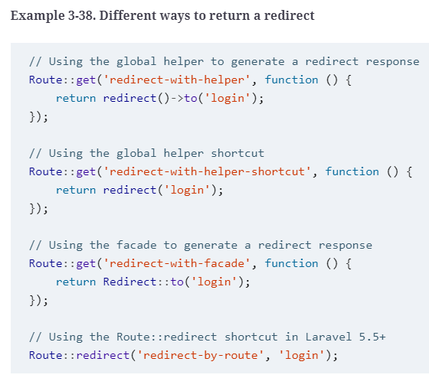
Redirects
Copyright © 2022 by Elephant Scale, All Rights Reserved
Notes:
So far the only things we’ve explicitly talked about returning from a controller method or route definition have been views. But there are a few other structures we can return to give the browser instructions on how to behave.
First, let’s cover the redirect. You’ve already seen a few of these in other examples. There are two common ways to generate a redirect; we’ll use the redirect() global helper here, but you may prefer the facade. Both create an instance of Illuminate\Http\RedirectResponse, perform some convenience methods on it, and then return it. You can also do this manually, but you’ll have to do a little more work yourself. Take a look at Example 3-38 to see a few ways you can return a redirect.
Note that the redirect() helper exposes the same methods as the Redirect facade, but it also has a shortcut; if you pass parameters directly to the helper instead of chaining methods after it, it’s a shortcut to the to() redirect method.
Also note that the (optional) third parameter for the Route::redirect() route helper can be the status code (e.g., 302) for your redirect.

Slide 110
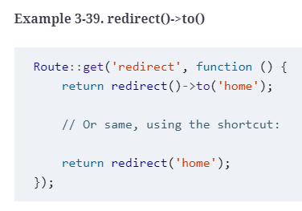
redirect()->to()
The method signature for the to() method for redirects looks like this:
function to($to = null, $status = 302, $headers = [], $secure = null)
Copyright © 2022 by Elephant Scale, All Rights Reserved
Notes:
$to is a valid internal path, $status is the HTTP status (defaulting to 302), $headers allows you to define which HTTP headers to send along with your redirect, and $secure allows you to override the default choice of http versus https (which is normally set based on your current request URL). Example 3-39 shows an example of its use.

Slide 111
redirect()->route()
The route() method is the same as the to() method, but rather than pointing to a particular path, it points to a particular route name (see Example 3-40).
Example 3-40. redirect()->route()
Route::get('redirect', function () {
return redirect()->route('conferences.index');
});
Copyright © 2022 by Elephant Scale, All Rights Reserved

Slide 112
redirect()->route()
Note that, since some route names require parameters, its parameter order is a little different. route() has an optional second parameter for the route parameters:
function route($to = null, $parameters = [], $status = 302, $headers = [])
So, using it might look a little like Example 3-41.
Example 3-41. redirect()->route() with parameters
Route::get('redirect', function () {
return redirect()->route('conferences.show', ['conference' => 99]);
});
Copyright © 2022 by Elephant Scale, All Rights Reserved
Notes:
redirect()->back()
Because of some of the built-in conveniences of Laravel’s session implementation, your application will always have knowledge of what the user’s previously visited page was. That opens up the opportunity for a redirect()->back() redirect, which simply redirects the user to whatever page they came from. There’s also a global shortcut for this: back().
Other Redirect Methods
The redirect service provides other methods that are less commonly used, but still available:
home()
Redirects to a route named home.
refresh()
Redirects to the same page the user is currently on.
away()
Allows for redirecting to an external URL without the default URL validation.
secure()
Like to() with the secure parameter set to "true".
action()
Allows you to link to a controller and method in one of two ways: as a string (redirect()->action('MyController@myMethod')) or as a tuple (redirect()->action([MyController::class, 'myMethod'])).
guest()
Used internally by the authentification system (discussed in lesson 9); when a user visits a route they’re not authenticated for, this captures the “intended” route and then redirects the user (usually to a login page).
intended()
Also used internally by the auth system; after a successful authentication, this grabs the “intended” URL stored by the guest() method and redirects the user there.

Slide 113
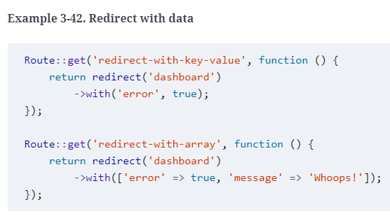
redirect()->with()
Most commonly, you can pass along either an array of keys and values or a single key and value using with(), like in Example 3-42.
This saves your with() data to the session just for the next page load.
Copyright © 2022 by Elephant Scale, All Rights Reserved
Notes:
While it is structured similarly to the other methods you can call on redirect(), with() is different in that it doesn’t define where you’re redirecting to, but what data you’re passing along with the redirect. When you’re redirecting users to different pages, you often want to pass certain data along with them. You could manually flash the data to the session, but Laravel has some convenience methods to help you with that.

Slide 114
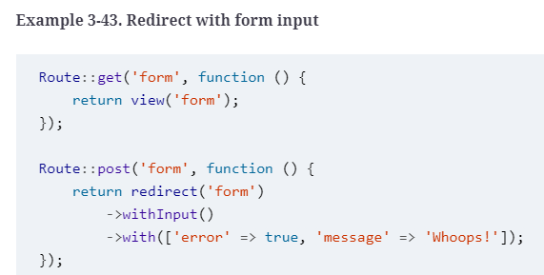
redirect()->with()
You can also use withInput(), as in Example 3-43, to redirect with the user’s form input flashed; this is most common in the case of a validation error, where you want to send the user back to the form they just came from.
Copyright © 2022 by Elephant Scale, All Rights Reserved
Notes:
CHAINING METHODS ON REDIRECTS
As with many other facades, most calls to the Redirect facade can accept fluent method chains, like the with() calls in Example 3-42. You’ll learn more about fluency in “What Is a Fluent Interface?”.
The easiest way to get the flashed input that was passed with withInput() is using the old() helper, which can be used to get all old input (old()) or just the value for a particular key as shown in the following example, with the second parameter as the default if there is no old value).

Slide 115
redirect()->with()
You’ll commonly see this in views, which allows this HTML to be used both on the “create” and the “edit” view for this form:
<input name="username" value="<?=
old('username', 'Default username instructions here');
?>">
Copyright © 2022 by Elephant Scale, All Rights Reserved
Notes:
Speaking of validation, there is also a useful method for passing errors along with a redirect response: withErrors(). You can pass it any “provider” of errors, which may be an error string, an array of errors, or, most commonly, an instance of the Illuminate Validator, which we’ll cover in lesson 10. Example 3-44 shows an example of its use.

Slide 116
redirect()->with()
Example 3-44. Redirect with errors
Route::post('form', function (Illuminate\Http\Request $request) {
$validator = Validator::make($request->all(), $this->validationRules);
if ($validator->fails()) {
return back()
->withErrors($validator)
->withInput();
}
});
Copyright © 2022 by Elephant Scale, All Rights Reserved
Notes:
withErrors() automatically shares an $errors variable with the views of the page it’s redirecting to, for you to handle however you’d like.
THE VALIDATE() METHOD ON REQUESTS
Don’t like how Example 3-44 looks? There’s a simple and powerful tool that will make it easy for you to clean up that code. Read more in “validate() on the Request Object”.

Slide 117
Aborting the Request
Example 3-45 shows, abort_if() and abort_unless() take a first parameter that is evaluated for its truthiness and perform the abort depending on the result.
Example 3-45. 403 Forbidden aborts
Route::post('something-you-cant-do', function (Illuminate\Http\Request $request) {
abort(403, 'You cannot do that!');
abort_unless($request->has('magicToken'), 403);
abort_if($request->user()->isBanned, 403);
});
Copyright © 2022 by Elephant Scale, All Rights Reserved
Notes:
Aside from returning views and redirects, the most common way to exit a route is to abort. There are a few globally available methods (abort(), abort_if(), and abort_unless()), which optionally take HTTP status codes, a message, and a headers array as parameters.

Slide 118
Custom Responses
There are a few other options available for us to return, so let’s go over the most common responses after views, redirects, and aborts.
Just like with redirects, you can run these methods on either the response() helper or the Response facade.
Copyright © 2022 by Elephant Scale, All Rights Reserved
Notes:
response()->make()
If you want to create an HTTP response manually, just pass your data into the first parameter of response()->make(): for example, return response()->make(Hello, World!). Once again, the second parameter is the HTTP status code and the third is your headers.
response()->json() and ->jsonp()
To create a JSON-encoded HTTP response manually, pass your JSON-able content (arrays, collections, or whatever else) to the json() method: for example return response()->json(User::all()). It’s just like make(), except it +json_encode+s your content and sets the appropriate headers.

Slide 119
response()->download(), ->streamDownload(), and ->file()
If you want to make some content from an external service available as a download without having to write it directly to your server’s disk, you can stream the download using response()->streamDownload().
This method expects as parameters a closure that echoes a string, a filename, and optionally an array of headers; see Example 3-46.
Example 3-46. Streaming downloads from external servers
return response()->streamDownload(function () {
echo DocumentService::file('myFile')->getContent();
}, 'myFile.pdf');
Copyright © 2022 by Elephant Scale, All Rights Reserved
Notes:
To send a file for the end user to download, pass either an SplFileInfo instance or a string filename to download(), with an optional second parameter of the download filename: for example, return response()->download('file501751.pdf', 'myFile.pdf'), which would send a file that’s at file501751.pdf and rename it, as it’s sent, myFile.pdf.
To display the same file in the browser (if it’s a PDF or an image or something else the browser can handle), use response()->file() instead, which takes the same parameters as response->download().

Slide 120
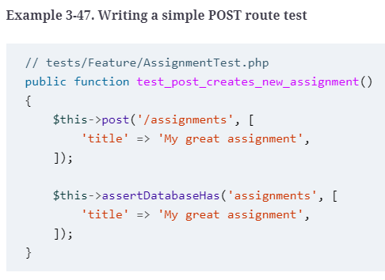
Testing
Copyright © 2022 by Elephant Scale, All Rights Reserved
Notes:
In some other communities the idea of unit-testing controller methods is common, but within Laravel (and most of the PHP community) it’s typical to rely on application testing to test the functionality of routes.
For example, to verify that a POST route works correctly, we can write a test like Example 3-47.

Slide 121
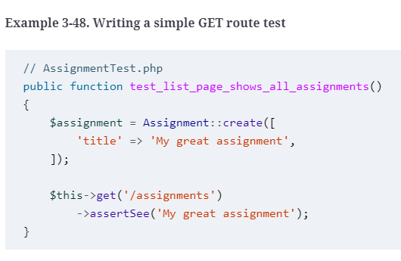
Testing
You can also use similar syntax to visit a route and verify that certain text shows up on the page, or that clicking certain buttons does certain things (see Example 3-48).
Copyright © 2022 by Elephant Scale, All Rights Reserved
Notes:
Did we directly call the controller methods? No. But we ensured that the goal of this route—to receive a POST and save its important information to the database—was met.
DIFFERENT NAMES FOR TESTING METHODS PRIOR TO LARAVEL 5.4
In projects running versions of Laravel prior to 5.4 assertDatabaseHas() should be replaced by seeInDatabase(), and get() and assertSee() should be replaced by visit() and see().
TL;DR
Laravel’s routes are defined in routes/web.php and routes/api.php. You can define the expected path for each route, which segments are static and which are parameters, which HTTP verbs can access the route, and how to resolve it. You can also attach middleware to routes, group them, and give them names.
What is returned from the route closure or controller method dictates how Laravel responds to the user. If it’s a string or a view, it’s presented to the user; if it’s other sorts of data, it’s converted to JSON and presented to the user; and if it’s a redirect, it forces a redirect.
Laravel provides a series of tools and conveniences to simplify common routing-related tasks and structures. These include resource controllers, route model binding, and form method spoofing.

Slide 122
Blade Templating
Copyright © 2022 by Elephant Scale, All Rights Reserved

